Slide 1




Improved Culling for Tiled and Clustered Rendering
Michal Drobot
Principal Rendering Engineer

Slide 2

© 2017 Activision Publishing, Inc.
Notes:
This talk will present novel culling techniques developed for Call of Duty : Infinite Warfare

Slide 3
Plus(+) Methods: Introduction

Slide 4
Plus(+) Methods: Algorithm Steps
List of rendering entities
Spatial acceleration structure with culled entity lists
Execution algorithm per sampling point
Traverse acceleration structure
Iterate over existing entities
Also known as Tiled / Clustered Forward+/Deferred+
Notes:
In recent years we got used to multiple Forward+ / Deferred+ methods.
Most popular one is light culling [JOH09], but similar algorithms have been successfully implemented for many other rendering entities such as decals [SOU16], reflection probes [SOU16], volumetrics [DRO17].
A basic implementation consists of:
- List of rendering entities
- Spatial acceleration structure with culled entity lists
- Execution algorithm that runs for each entity per sampling point. It is capable of traversing the data structure as well as executing operations on individual entities ( i.e. decal application or light shading ).

Slide 5
Spatial acceleration structure : Frustum
Tile
Depth pre-pass
Cull entities against tile boundaries and depth min / max
2D dense grid
i.e. 8x8 pixel tiles
Suffers from depth discontinuities
Notes:
Frustum space is known to be efficient and easily scalable with resolution and complexity.
A basic acceleration structure would be a 2D Tile grid.
It requires a depth pre-pass for efficient culling.
Entities get culled against tile min and max Z planes (Z planes are derived from depth buffer values within the tile).
Tile approach, due to low memory consumption, allows high resolution.
Unfortunately it suffers from depth discontinuities. If a single tile contains depth values far away from each other, culling efficiency will be suboptimal as multiple entities between min and max Z will end up pulled into the tile.
This can also result in pulling entities that are not even within Z ranges of each individual depth value within the tile.

Slide 6
Spatial acceleration structure : Frustum
Cluster
No need for depth pre-pass - cull entities against 3D clusters
Allows arbitrary 3D ( within frustum ) lookup
Depth discontinuities mitigated as much as memory consumption allows
Z – slice distribution
Likely sparse in 2D due to memory consumption
Notes:
Cluster approach works fully in 3D and does not require depth pre-pass.
Instead frustum is divided into a predefined amount of clusters – mini frustas.
Assuming that that clusters cover the view frustum, looking up values for each point in space is a trivial 3D lookup in frustum space.
Also depth discontinuities are partially mitigated due to fragmentation of space in Z dimension (as opposed to tile approach).
However, such benefit comes at a cost of storing multiple Z slices of clusters, as opposed to single slice of tiles.
Therefore X/Y resolution of clustered buffers seems to be rather low in comparison with tile buffers – thus resulting in suboptimal culling.

Slide 7
Data Structure Divergence performance issues
0
1
Tile
In Forward a triangle can cross multiple tiles
In Deferred wavefront can be matched to tile size
Cluster
In Forward a triangle can cross multiple clusters
In Deferred a wavefront can cross multiple Z slices
Voxel Tree
Wavefront can cross multiple voxels
Triangle / Texel
Wavefront can cross multiple triangles / texels
2
3
Tile
Packed
Wavefront
Pixel
0
1
0
0
1
0
0
1
2
3
2
2
2
Notes:
Processed by modern GPUs, each of aforementioned structures can suffer from divergence issues.
When a pixel or compute shader wavefront reads and processes the data structure, internal divergence can occur.
Same wavefront can cross multiple tiles, clusters, voxels, triangles – causing threads to read from multiple data sources.
Some data structures allow to minimize divergence ( i.e. matching deferred kernel size to data structure layout ) but eventually divergence can’t be avoided due to other dimensions.
In PS increased divergence can be caused by helper threads and scan converter patterns packing multiple pixels together into wavefront, where each pixel can be spatially far away from each other.
There can be more points of divergence such as entity type divergence, albeit for simplicity we focus on data structure divergence only.

Slide 8
Divergence performance issues
High VMEM and VALU cost
All calculations past divergence point ( i.e. within tile ) happen per vector
All memory loads, even if coherent, will happen per vector thus spamming TCC units
Memory arithmetic will happen per vector adding to VALU cost
High VGPR cost
Because all operations are vector based, all constant data ( such as entity descriptors ) will have to be loaded into VGPRs

Slide 9
Data Structures & Scalarization

Slide 10
Scalarization
Execute wavefront only on one divergent item at a time
Loop over all items sampled by wavefront
Mask all wavefront lanes to work only on selected item
Move to next
Can be used in Forward as well as in Deferred
Vectorized
Scalarized
Thread 0
Item 0 (20 VGPR)
Scalar Memory Unit
Thread 1
Item 1 (20 VGPR)
Item 0 (20 VGPR)
Item 1 (20 VGPR)
Item 3 (20 VGPR)
Item 2 (20 VGPR)
Thread 2
Item 2 (20 VGPR)
Thread 3
Item 3 (20 VGPR)
Vector Memory Unit
VGPR Total : 80 VGPR
VGPR Total : 20 VGPR
Notes:
Scalarization is a process of changing a divergent vectorized algorithm into serialized coherent one.
Serialization happens over items in order to improve throughput as well as utilize several hardware features reserved for coherent execution.
In case of GCN it allows conscious balancing of Scalar Memory Unit and Vector Memory unit, along with GPU wavefront occupancy.

Slide 11
Data Container : Hierarchical
Pointer to leaf cluster
Leaf cluster stores all pointers to visible entities inside each entry
Not bound by entity number
Expensive traversal due to indirection
Variable memory storage cost
Global | 0 | 1 | 2 | 3 | 4 | 5 | 6 | 7 | … | N
Leaf payload
( same leaves should be merged )
Entity Idx | 0 | 1
Pointer | 5 | 7
2D/3D Lookup
Spatial Acceleration Structure with leaf pointers
Leaf Header
Head Ptr | Entity # : 2
Execute on entities 5 & 7

Slide 12
Scalarization : Baseline
// Typical Hierarchical Container iterator
address = containerAddressFromSamplePosition( samplePosition ); // Find address of container for 2D / 3D position
// First entry is the header. Read and advance pointer
header = g_EntityClusterData[address++];
entityCount = GetEntityCountFromHeader( header );
// Iterate over entities inside the container
for ( entityItr = 0; entityItr < entityCount; entityItr++ )
ProcessEntity( g_EntityClusterData[address++] );

Slide 13
Scalarization : Baseline
// Hierarchical Container iterator scalarized over containers
address = containerAddressFromSamplePosition( samplePosition ); // Find address of container for 2D / 3D position
uniformAddress = address;
currentLaneID = WaveGetLaneIndex();
execMask = ~ulong( 0 ); // init mask to 111…111 – open for all lanes
ulong currentLaneMask = ulong( ulong( 1 ) << ulong( currentLaneID ) );
while ( ( execMask & currentLaneMask ) != 0 ) // set EXEC to remaining lanes
{
uniformAddress = WaveReadFirstLane( address );
laneMask = WaveBallot( uniformAddress == address ); // mask of lanes to be processed in current iteration
execMask &= ~laneMask; // remove currently alive lanes from mask
if ( uniformAddress == address ) // execute for lanes with matching coherent address
{
header = g_EntityClusterData[uniformAddress++]; // First entry is the header. Read and advance pointer
entityCount = GetEntityCountFromHeader( header );
// Iterate over entities inside the container
for ( entityItr = 0; entityItr < entityCount; entityItr++ )
ProcessEntity( g_EntityClusterData[uniformAddress++] );
}
}

Slide 14
Scalarization : Hierarchical Container
Shader is fully scalarized
Better VMEM/SMEM and VALU/SALU balancing
Low VGPR usage ( similar to Forward constant loading )
Performance highly variable
Wavefront can process entities multiple times if same entities are in different containers
Depending on data coherency / redundancy this can result in slowdown
Ideally scalarize on entity level
This requires ordered containers - Flat Bit Arrays

Slide 15
Data Container: Flat
Flat Bit Array
Collection of bits – Nth bit representing visibility of Nth entity from global list
Simple traversal – iterate through bits
Memory / Entity bound – mostly used in per-frustum context
Global | 0 | 1 | 2 | 3 | 4 | 5 | 6 | 7 | … | N
Store | 3 | 5 | 7 | 12
Idx | 0 | 1 | 2 | 3
Per-frustum culled list of M entities
2D/3D Lookup
Spatial Acceleration Structure with M bit entries
0 | 1 | 1 | 0
Execute on entities 5 & 7

Slide 16
Scalarization : Baseline
// Typical Flat Bit Array iterator
wordMin = 0;
wordMax = max( MAX_WORDS - 1, 0 );
address = containerAddressFromSamplePosition( samplePosition );
// Read range of words of visibility bits
for ( uint wordIndex = wordMin; wordIndex <= wordMax; wordIndex++ )
{
// Load bit mask data per lane
mask = entityMasksTile[address + wordIndex];
while ( mask != 0 ) // processed per lane
{
bitIndex = firstbitlow( mask );
entityIndex = 32 * wordIndex + bitIndex;
mask ^= ( 1 << bitIndex );
ProcessEntity( entityIndex );
}
}

Slide 17
Scalarization : Baseline
// Flat Bit Array iterator scalarized on entity
wordMin = 0;
wordMax = max( MAX_WORDS - 1, 0 );
address = containerAddressFromSamplePosition( samplePosition );
// Read range of words of visibility bits
for ( uint wordIndex = wordMin; wordIndex <= wordMax; wordIndex++ )
{
// Load bit mask data per lane
mask = entityMasksTile[address + wordIndex];
// Compact word bitmask over all lanes in wavefront
mergedMask = WaveReadFirstLane( WaveAllBitOr( mask ) );
while ( mergedMask != 0 ) // processed scalar over merged bitmask
{
bitIndex = firstbitlow( mergedMask );
entityIndex = 32 * wordIndex + bitIndex;
mergedMask ^= ( 1 << bitIndex );
ProcessEntity( entityIndex );
}
}

Slide 18
Scalarization : Flat Container
Bitmask Scalarization
Shader is fully scalarized and executes once per each entity
Low VGPR usage
Significantly more efficient than baseline
Arguably more elegant code
Results of scalarization on synthetic test shader
Scalarization applied to Light lookups in densely lit environment
 | VGPR Count | Occupancy | Cost
Base F+ | 56 | 5 | 100%
Hierarchical F+ Scalarized | 32 | 8 | 98%
Flat F+ Scalarized | 32 | 8 | 72%
Notes:
Synthetic test shader was using Sponza Atrium scene with 128 shadowed lights

Slide 19
Scalarization
Hierarchical Data Containers can be scalarized on container level
Tile / Cluster / Voxel address
Flat Data Containers can be scalarized on stored entity level
Light / Probe / Decal idx

Slide 20
Z-Binning

Slide 21
Z-Binning
Open world depth ranges
Clustering performance / memory impractical for high efficiency at high depth complexity
 | Depth Discontinuities | Spatial Resolution | Memory Scaling with Z
Tiles | - | + | +
Clusters | + | - | -
Notes:
Different data structures have different pros and cons.
Due to memory constraints most applications decide to re-compute entity acceleration structures in view space ( frustum space ).
Thus most used structures are tiles and clusters.

Slide 22
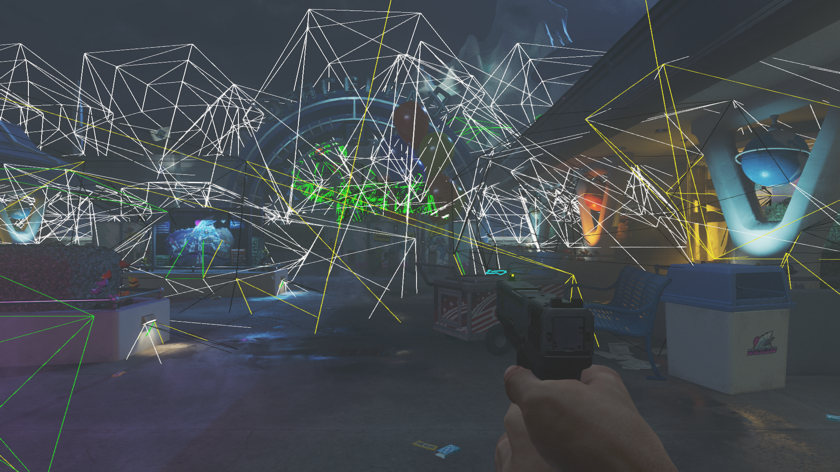
© 2017 Activision Publishing, Inc.
Notes:
Let us take a look at typical scene with large depth span.
This scene shows 256 lights spanned over 4 miles in Z

Slide 23
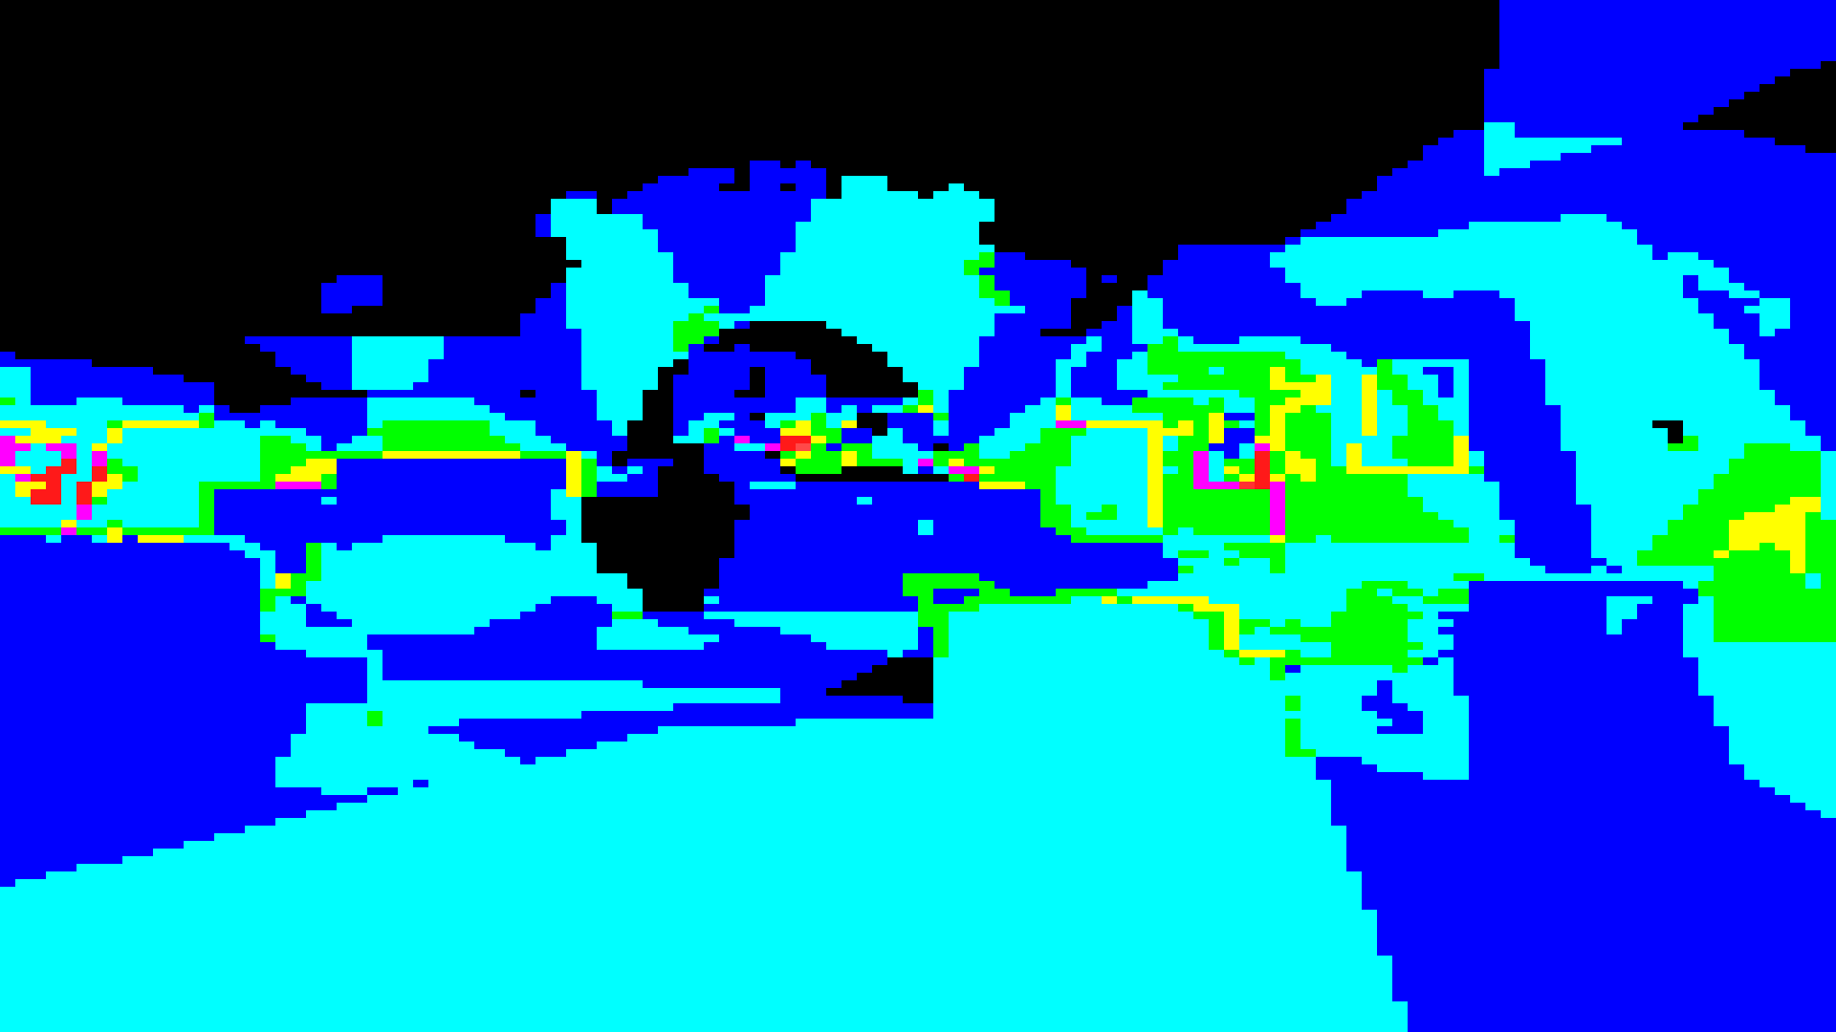
© 2017 Activision Publishing, Inc.
Notes:
This view shows sum of lights in all clusters in Z at same XY coordinates

Slide 24
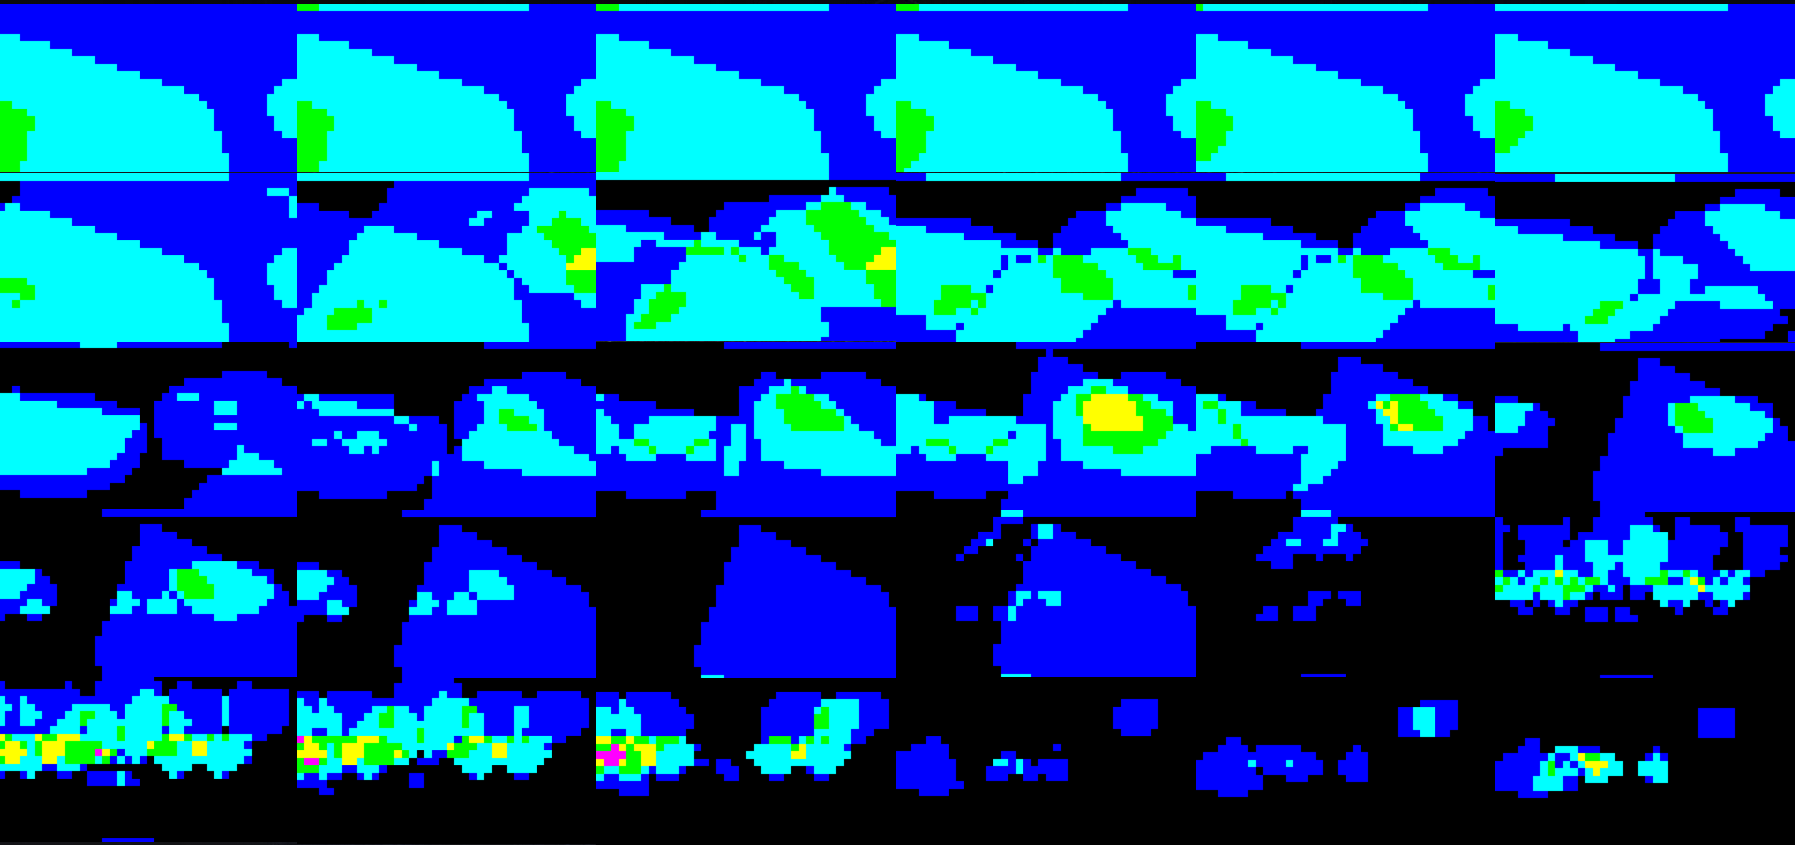
© 2017 Activision Publishing, Inc.
Notes:
Light counts from each Z slice from clustered buffer shown separately

Slide 25
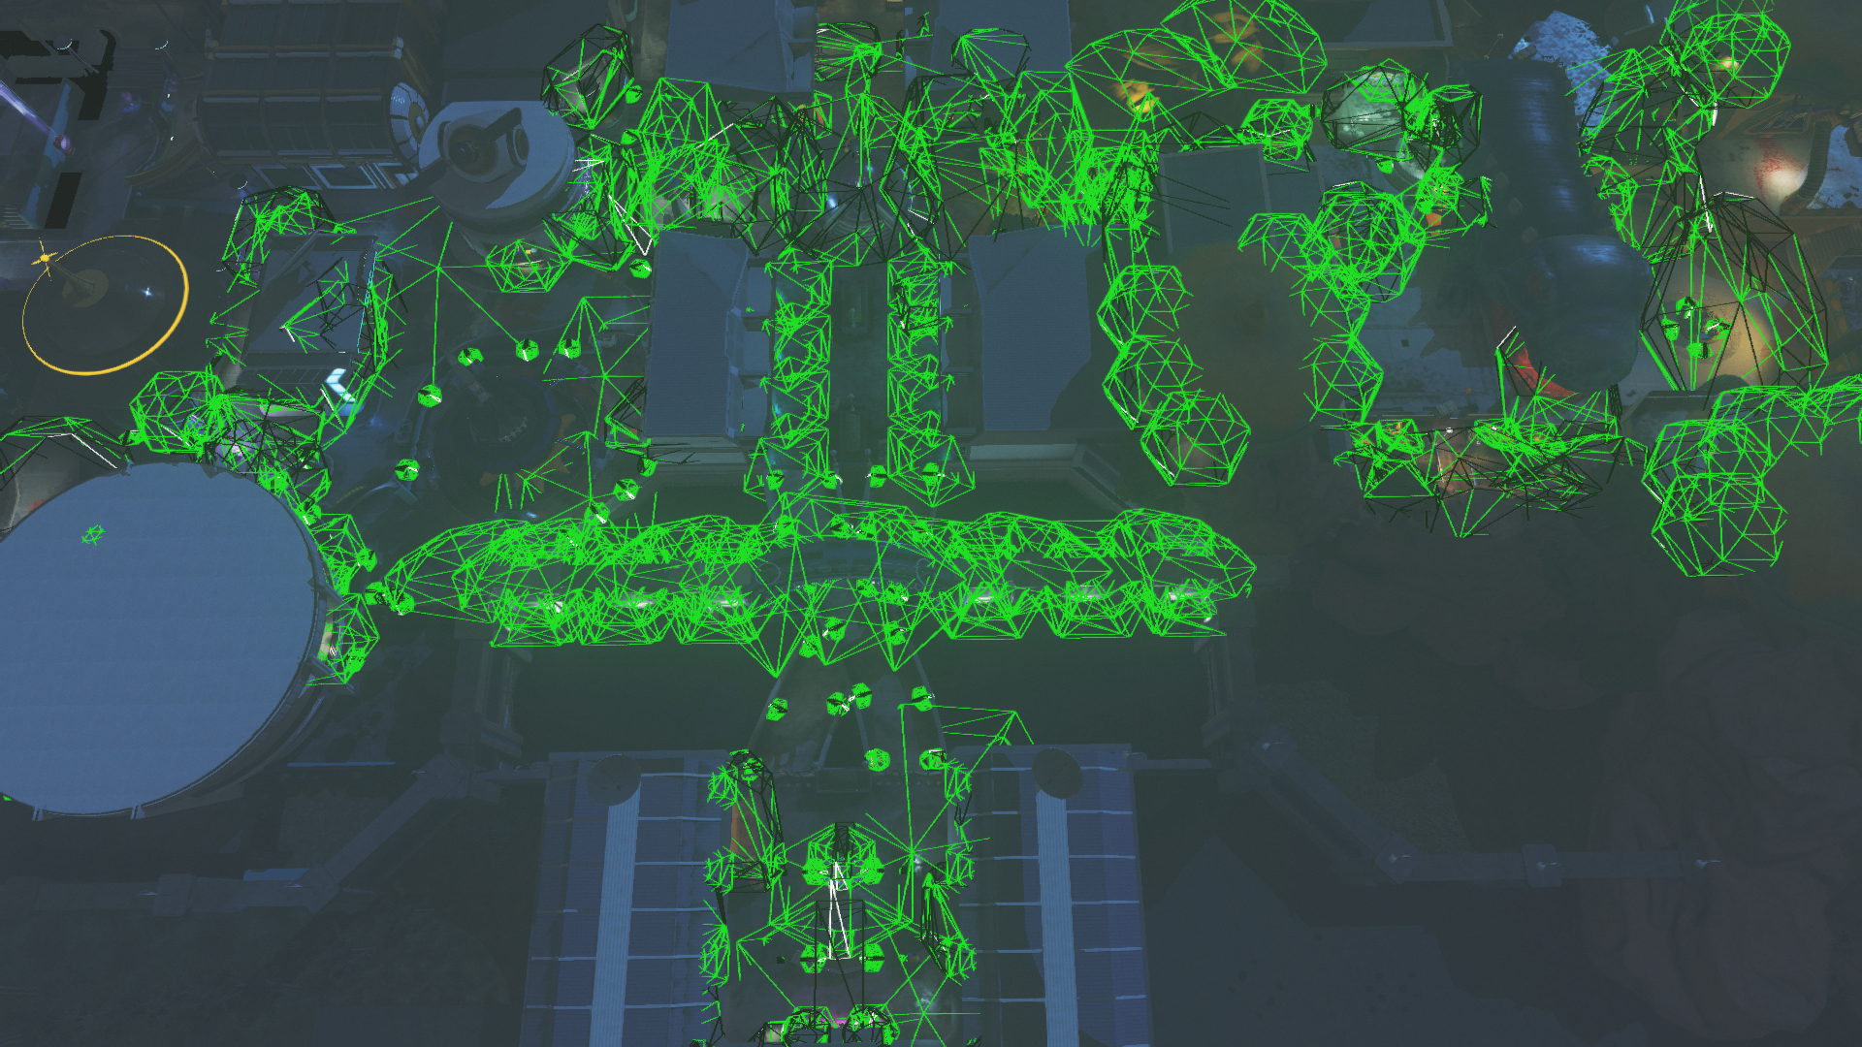
© 2017 Activision Publishing, Inc.
Notes:
Top Down view on lights in the level, visible from previous view
View frustum from previous first person view point
We can easily distinguish multiple lights grouped in a global Z slice
Going further we find another set of lights that share common Z slice
And more…
Now that we split the whole frustum in Z slices we can make an observation.
From camera POV lights from different slices can overlap in XY coordinates but will not overlap in Z – as they are separated in Z slices

Slide 26
Z-Binning
5
8
9
7
3
1
Notes:
Observation based on scene study:
Most lights do not overlap in X & Y & Z simultaneously
Decouple XY light culling from Z light culling
Most man-made environments overlap in XY from camera perspective. Your mileage may vary.

Slide 27
Z-Binning
Z-Bin Idx | Content
2 | 9 | 5 | 8
1 | 3 | 7
0 | 1
9
5
8
Z-Bin 2
3
7
Z-Bin 1
1
Z-Bin 0
Notes:
Z-Binning is a technique that enables decomposition of 3D acceleration structure ( such as cluster buffer ) into simpler and more compact structures.
Create two Structures : 2D Tile, 1D Z-Bins

Slide 28
Z-Binning
8
Z-Bin Idx | Content
2 | 9 | 5 | 8
1 | 3 | 7
0 | 1
9
5
3
7
*
~
1
Notes:
Evaluate intersection at lookup time
Intersection of Tiled buffer and Z-Bin Array is equivalent to Clustered buffers if light does not simultaneously overlap XY & Z

Slide 29
Z-Binning : Efficient LUT
ZBIN[ int( LinearZ / BIN_WIDTH ) ] = MIN_LIGHT_ID_IN_BIN | MAX_LIGHT_ID_IN_BIN
Idx | Data
5 | 3|5
4 | 1|2
3 | 1|1
2 | MAX|0
1 | 0|0
0 | MAX|0
9
5
8
4
5
3
3
7
2
1
1
0
Notes:
Index by linear depth
Bins have uniform width
Sort entities by distance to camera
Allows storing ranges within bins in MIN | MAX ID format
Value of MAX|0 marks an empty bin

Slide 30
F+ Renderer : Z-binning algorithm
CPU:
Sort lights by Z
Set uniformly distributed bins over total possible depth range
Generate 2 x 16bit LUT with MIN / MAX light ID within each bin boundaries
GPU ( PS / CS ):
Vector load ZBIN
Wave uniform LIGHT MIN / MAX ID
Wave uniform LOAD of light bit WORDS from MIN / MAX range
Create Vector bit mask from LIGHT MIN / MAX ID
Mask uniform lights by vector Z-Bin mask

Slide 31
Scalarization : Baseline
// Flat Bit Array iterator scalarized on entity with Z-Bin masked words
wordMin = 0;
wordMax = max( MAX_WORDS - 1, 0 );
address = containerAddressFromScreenPosition( screenCoords.xy );
zbinAddr = ContainerZBinScreenPosition( screenCoords.z );
zbinData = maskZBin.TypedLoad( zbinAddr, TYPEMASK_NUM_DATA( FORMAT_NUMERICAL_UINT, FORMAT_DATA_16_16 ) );
minIdx = zbinData.x;
maxIdx = zbinData.y;
mergedMin = WaveReadFirstLane( WaveAllMin( minIdx ) ); // mergedMin scalar from this point
mergedMax = WaveReadFirstLane( WaveAllMax( maxIdx ) ); // mergedMax scalar from this point
wordMin = max( mergedLightMin / 32, wordMin );
wordMax = min( mergedLightMax / 32, wordMax );
// Read range of words of visibility bits
for ( uint wordIndex = wordMin; wordIndex <= wordMax; wordIndex++ )
{
// … //
}

Slide 32
Scalarization : Baseline
// Read range of words of visibility bits
for ( uint wordIndex = wordMin; wordIndex <= wordMax; wordIndex++ )
{
// Load bit mask data per lane
mask = entityMasksTile[address + wordIndex];
// Mask by ZBin mask
uint localMin = clamp( (int)minIdx - (int)( wordIndex * 32 ), 0, 31 );
uint maskWidth = clamp( (int)maxIdx - (int)minIdx + 1, 0, 32 );
// BitFieldMask op needs manual 32 size wrap support
uint zbinMask = maskWidth == 32 ? (uint)(0xFFFFFFFF) : BitFieldMask( maskWidth, localMin );
mask &= zbinMask;
// Compact word bitmask over all lanes in wavefront
mergedMask = WaveReadFirstLane( WaveAllBitOr ( mask ) );
while ( mergedMask != 0 ) // processed scalar over merged bitmask
{
bitIndex = firstbitlow( mergedMask );
entityIndex = 32 * wordIndex + bitIndex;
mergedMask ^= ( 1 << bitIndex );
ProcessEntity( entityIndex );
}
}

Slide 33
F+ Renderer : Memory Performance
Structure ( 256 bit array ) | XY Resolution | Z Resolution | Complexity | Storage | Cull Operations Per Entity
Tiled Buffer | 240 x 135 | 1 | O( X * Y ) | 1,036 KB | 32400
Tiled + ZBin | 240 x 135 | 8096 | O( X * Y + Z ) | 1,036 KB + 32 KB | 32400 + 8096 (simple)
Clustered | 60 x 32 | 18 | O( X * Y * Z ) | 1,106 KB | 34560
Notes:
ZBin width : 32”| ZBin count : 8k
Covers 4.13 mile range at 32 inch precision in Z
XY Resolution : Tile = 8x8 pixels
ZBin stored as 8096 x ( UINT32 ) : MIN | MAX
Max frustum entity count = 2^16 = 65536
Clustered resolution was picked to roughly match memory consumption of tiled and Zbin buffers

Slide 34

© 2017 Activision Publishing, Inc.
Notes:
Heavy cinematic scene with significant depth discontinuities

Slide 35
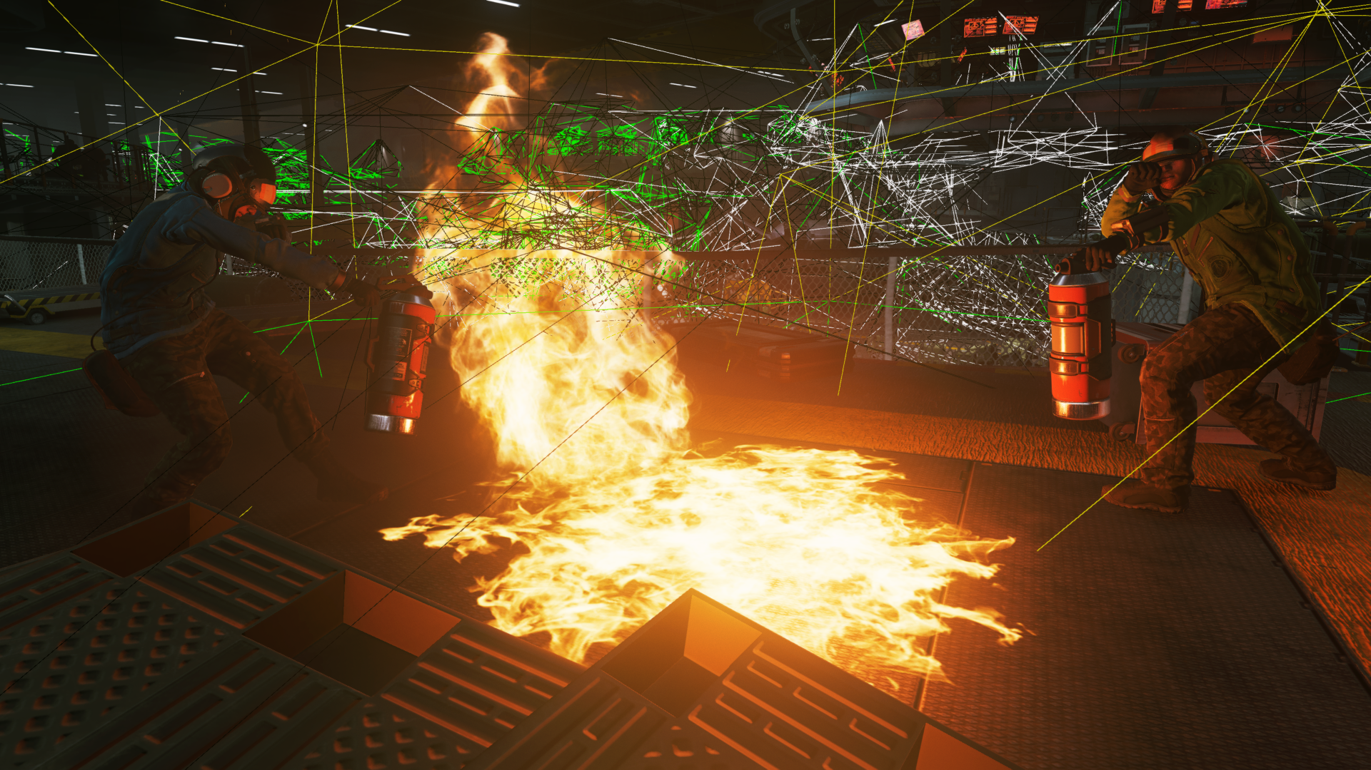
Light Shapes
© 2017 Activision Publishing, Inc.
Notes:
Multiple lights at different Z distances

Slide 36
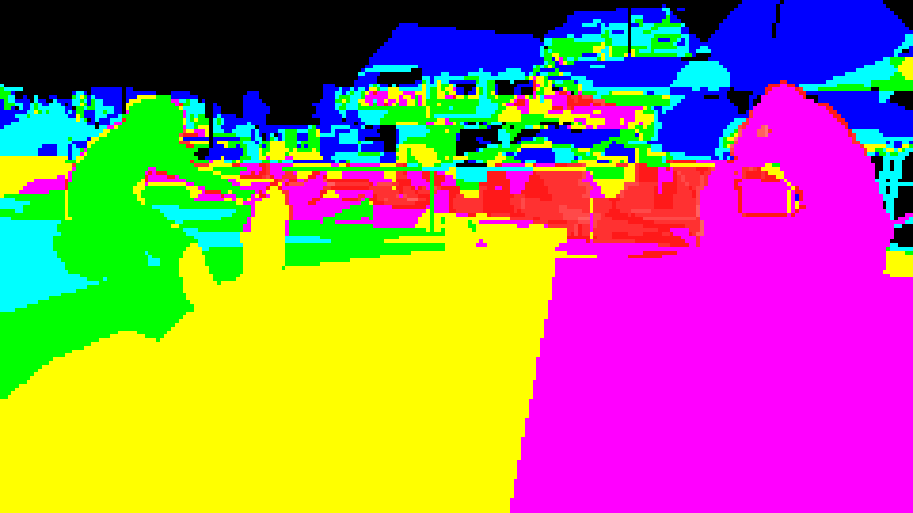
Tiled Bitmask

Slide 37
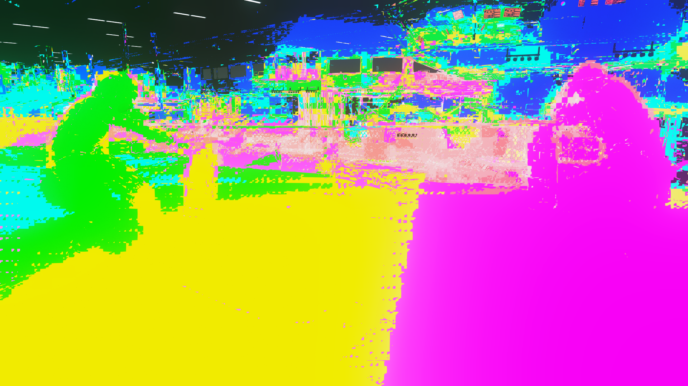
Effective Light Evaluations
Notes:
In Forward+ notice how helper lanes and rasterization patterns result in higher light counts for wavefronts near depth discontinuities.

Slide 38
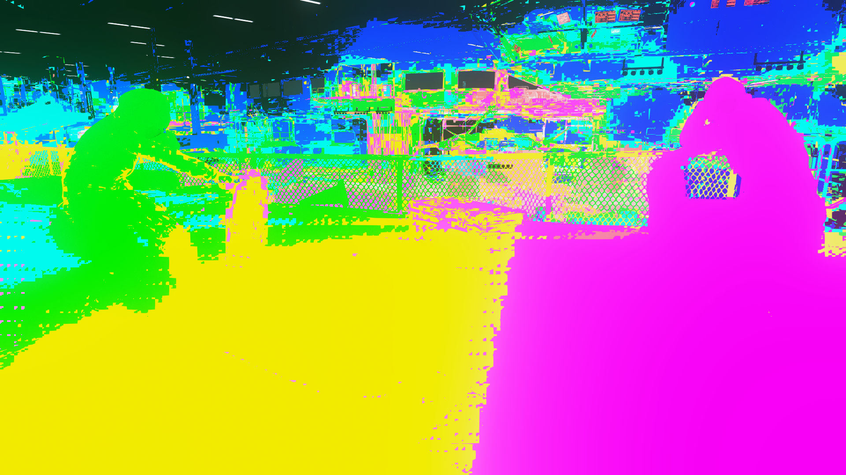
Z-Binning Enabled
Notes:
Z-Binning enabled results in close to perfect pixel culling near depth discontinuities.

Slide 39
F+ Renderer : Z-Bin Performance
Hangar Fire Scene (PS4 1080p)
Structure ( 256 bit array ) | Opaque render time
Tiled Buffer | 9.00 ms
Tiled + Zbin | 7.65 ms ( 15%)
Notes:
ZBin LUT always in L1/L2 cache
Lower VMEM bandwidth for limited BIT ARRAY WORDS
Close to optimal culling
Can also be used for fine culling level of Clustered Buffers
Used for Volumetrics
Repeatable performance improvement

Slide 40
F+ Renderer : Optimization Performance
Zombies opening scene (PS4 1080p)
Structure ( 256 bit array ) | PS Opaque pass time | PS Opaque pass average occupancy
Base Tile | 5.7 ms ( 100% ) | ~3
Based Tile + ZBin | 5.2 ms ( 91%) | ~3
Scalarized Tile | 5.1 ms ( 88% ) | ~4.3
Scalarized Tile + ZBin | 4.6 ms ( 80% ) | ~4.3
Notes:
Measurements on production map
Shaders fully ‘ship’ quality optimized
Comparison isolated to iterators / scalarization / ZBinning
64 reflection probes in view
256 lights in view
F+ shaders do all rendering : Lights, Probes, SSR, Shadows, Decals

Slide 41
Rasterization based culling

Slide 42
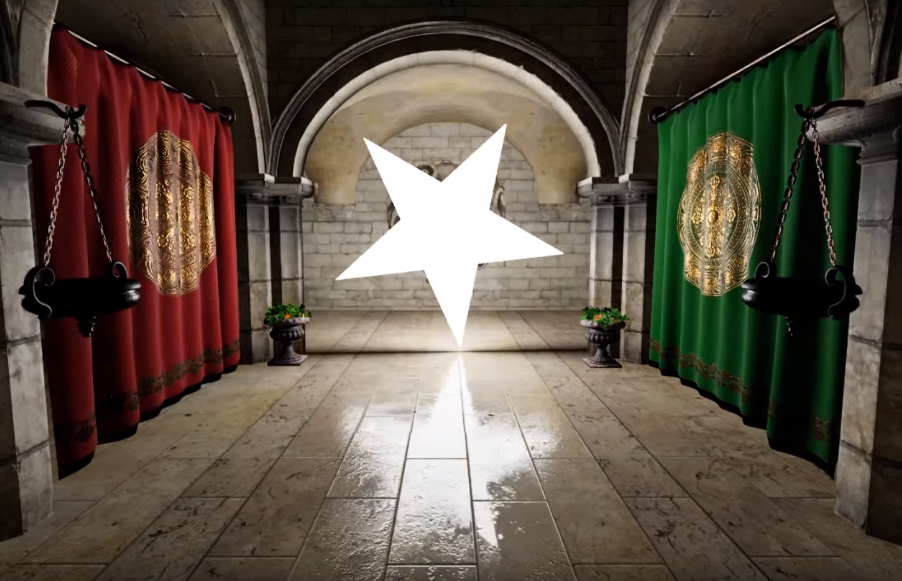
Classic compute culling issues
Accuracy [WRO17]
Occlusion [KAS11]
Complex shapes [HEI16]
Solution?
Classic Rasterized Deferred Rendering [HAR04]
Image courtesy of Eric Heiz
Image courtesy of Universal Pictures
Notes:
Classic compute culling suffers from multiple issues
It is hard to get good accuracy without sacrificing performance. It gets even harder for more complex shapes, especially in projection space.
There is no robust way to handle occlusion, due to geometry shadowing, as we are limited to analytic shapes.
Modern complex area lights complicate it further. Now lights can be constructed from arbitrary polygons, thus analytic shapes will be either overly conservative, or end up being polygons.
Solution?
Let’s go back a decade ago to good old days of rasterizer based deferred shading, where all those problems could be solved due to usage or explicit triangular meshes.

Slide 43
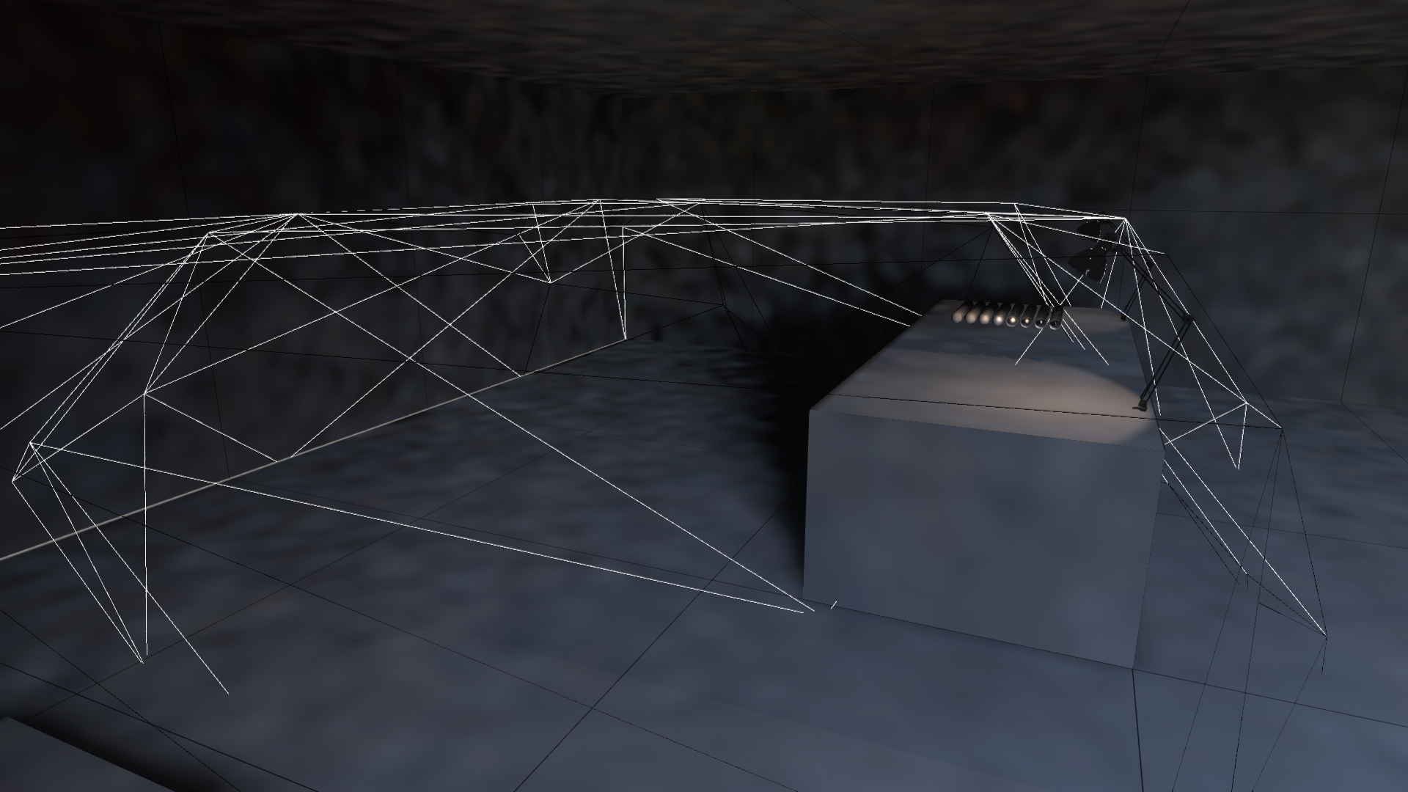
Light proxy
© 2017 Activision Publishing, Inc.
Notes:
Lights represented by triangular meshes, that are cut tightly to surrounding geometry.

Slide 44
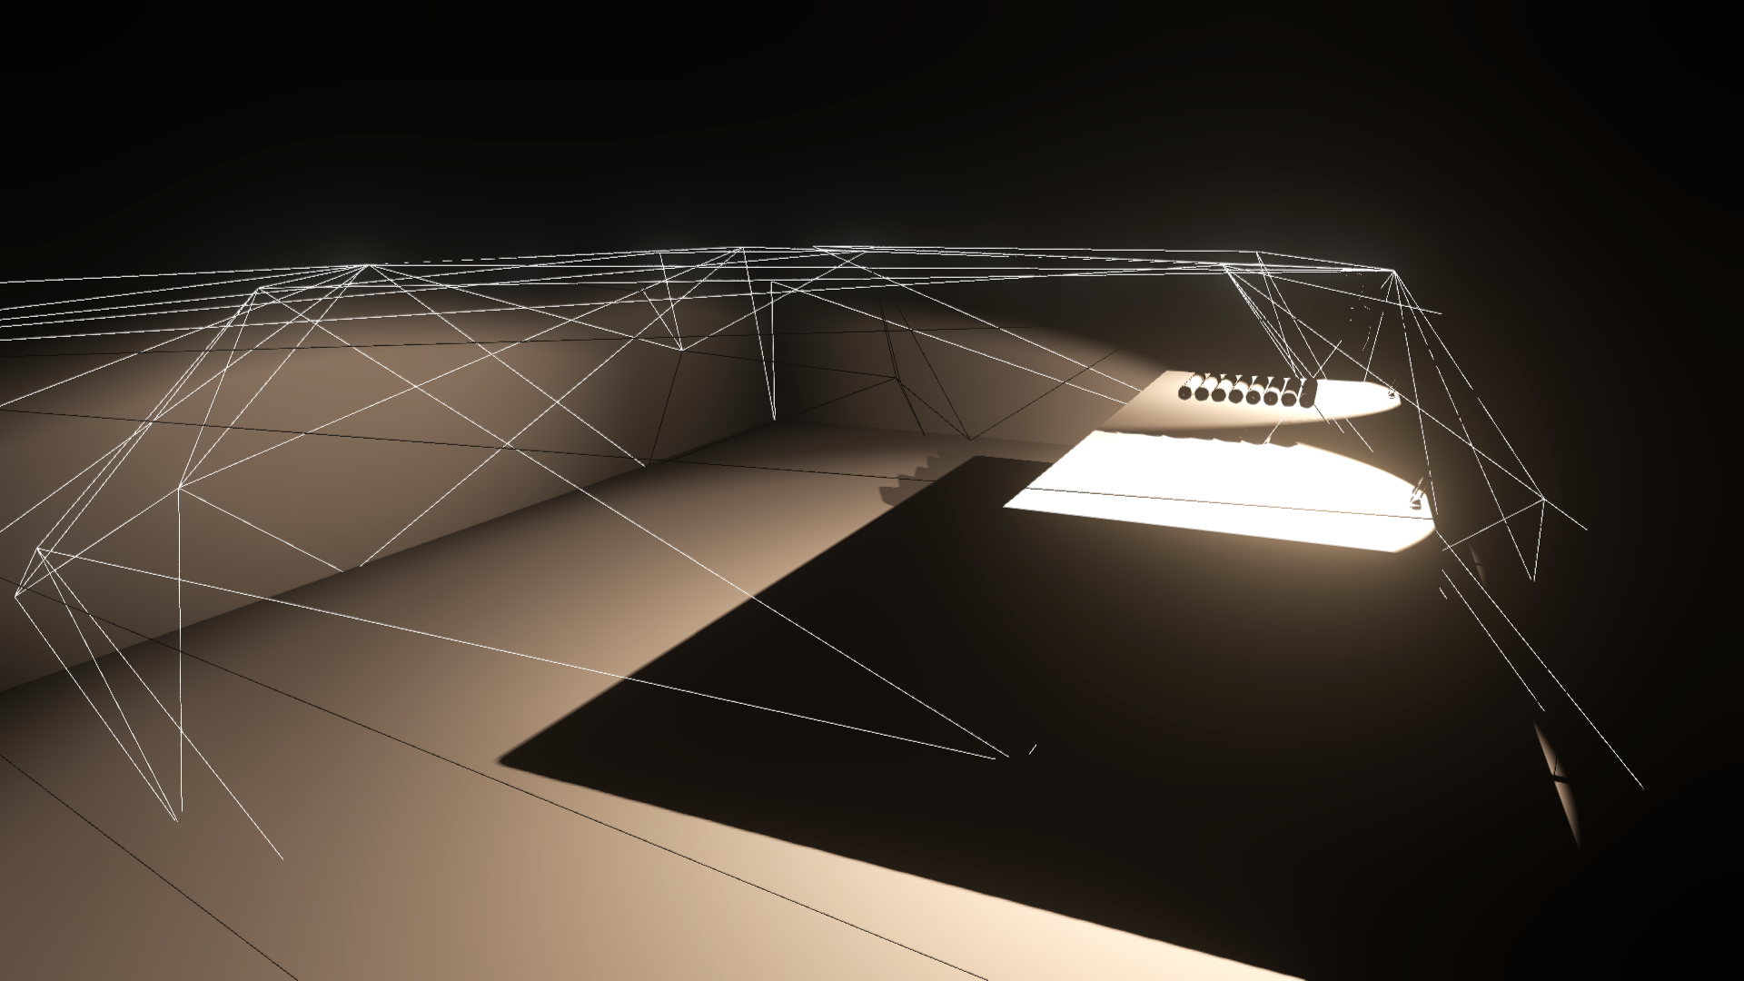
Light proxy
Direct light only
© 2017 Activision Publishing, Inc.
Notes:
Same view, now showing direct light contribution only to show tightly culled affected regions.

Slide 45
Conservative Rasterized Culling
Light is a mesh ( Light Proxy )
Atomic writes to tiles / clusters
InterlockedOR lightBit bit for Flat Bit Array
Conservative Rasterization w/o Hw support
Rasterize at full resolution
4xMSAA for speedup [DRO17]
Fixed pipeline HW optimizations
EarlyZ (HiZ)
Depth Bounds Test (HiZ)
Stencil (HiS)
Tile | 0 | 1 | 2 | 3
Lights | 0000 | 0010 | 0000 | 0010
0
1
InterlockedOR
Light Mesh 3
InterlockedOR
2
3
Notes:
All our lights are meshes. We call them light proxies.
Each proxy, during rasterization, writes into a tile, that it overlaps.
Writes are done through AtomicOR operations for conservative results.
Tiles are storing flat bit arrays of culled lights.
Our shipping targets are consoles which lack support for conservative rasterization.
Therefore we rasterize at full resolution, using MSAA for speedup.
This also allows us to use all fixed hardware optimizations, that are well researched for classic deferred rendering.

Slide 46
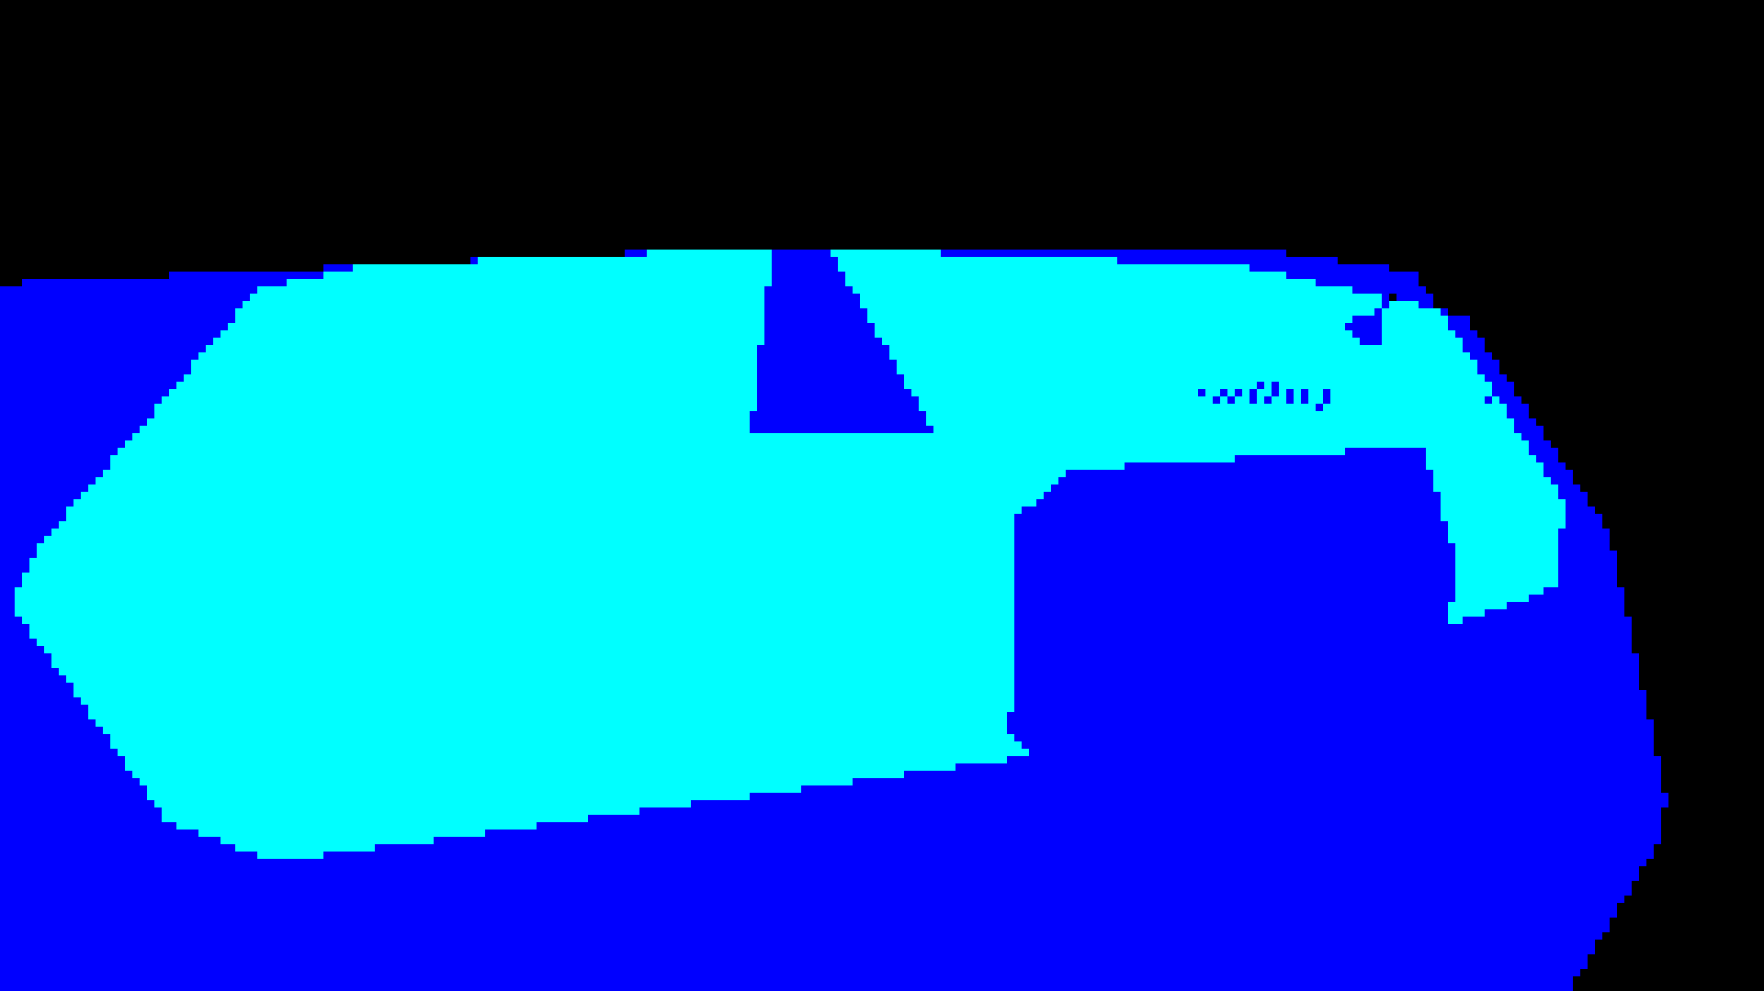
© 2017 Activision Publishing, Inc.
Tile Rasterization in 1 pass
EarlyZ + Depth Bounds Test
8x8 pixel tiles
Pixels inside light mesh volume run PS and InterlockOR lighBit to tiles
If camera inside light mesh
Z Mode = Greater
Render BACKFACES
Notes:
If camera is inside light hull, 1 pass method results in optimal culling.
For camera vs. light mesh checks, we do full half plane triangle checks for closest light triangles.

Slide 47
© 2017 Activision Publishing, Inc.
Tile Rasterization in 1 pass
EarlyZ + Depth Bounds Test
8x8 pixel tiles
If camera outside light mesh
Z Mode = LESS_EQUAL
Render FRONTFACES
Set Depth Bounds Test to mesh Z spans
Notes:
If camera is outside light mesh, single pass method, will result in overly conservative culling.
Efficiency will degenerate with non-uniform shapes that result in large depth spans set for Depth Bound Test.

Slide 48
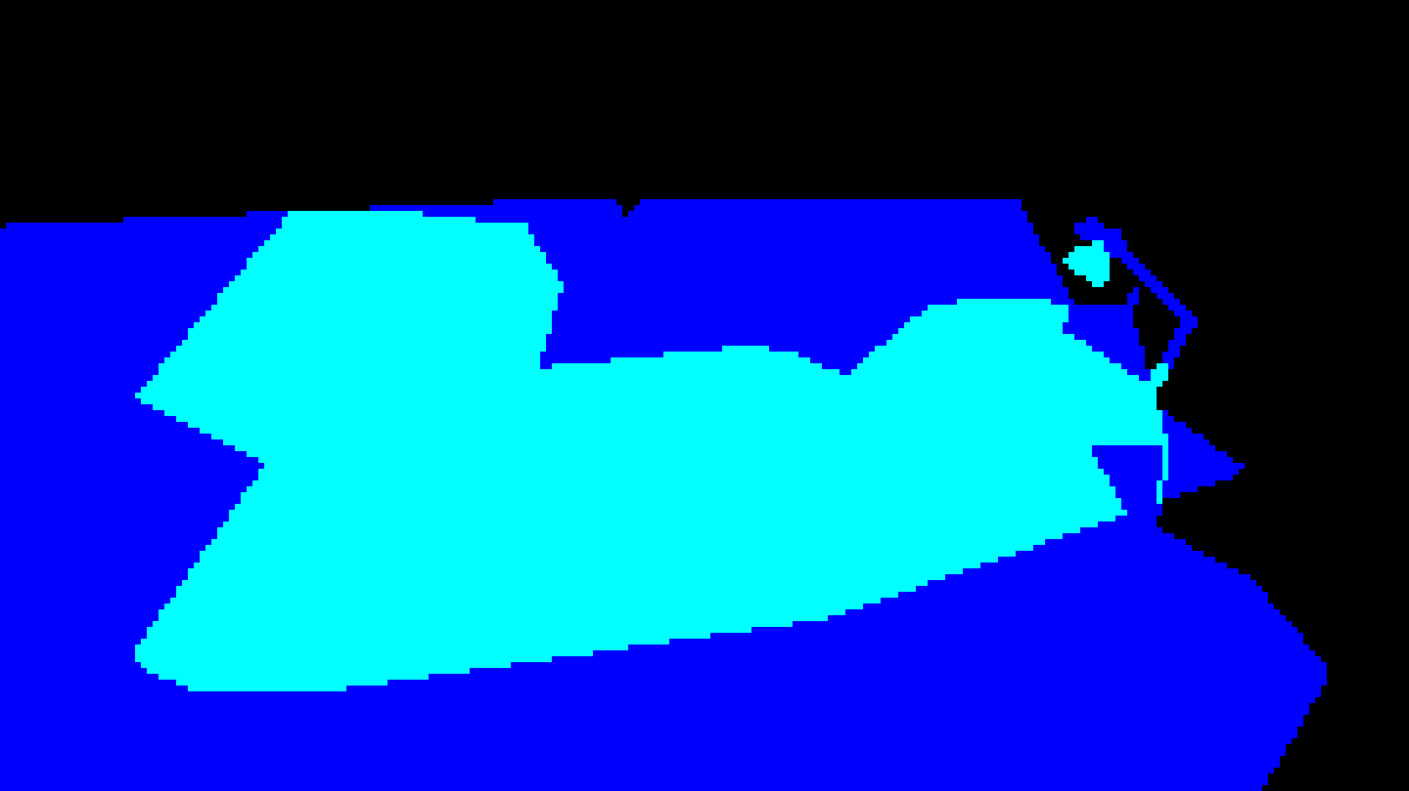
© 2017 Activision Publishing, Inc.
Tile Rasterization in 2 passes
EarlyZ + Depth Bounds Test + Stencil
8x8 pixel tiles
If camera outside light mesh ( 2 pass pixel perfect test )
1st pass stencil FRONT
2st pass stencil BACK and run PS
See for details [THI11]
Notes:
For additional, pixel perfect, culling accuracy we allow 2 pass stencil algorithm.
It is used only for closest lights in scenes with high depth complexity.

Slide 49
Scalarization : Baseline
// Used on Flat Bit Array
[earlydepthstencil] // make sure to enable EarlyZ with UAV
void ps_main( const PixelInput pixel )
{
uint tileIndex = FrustumGrid_TileFromScreenPos( rasterizerScale * pixel.position.xy ); // scale to MSAA raster
uint lightIndex = uint( entityID.x );
const uint lightBit = 1 << ( lightIndex % 32 ); // find correct light bit
const uint word = lightIndex / 32;
const uint wordIndex = ( tileIndex * FRUSTUM_GRID_FRAME_WORDS_LIGHTS ) + word; // find correct word
{
InterlockedOr( lightMasksTile[wordIndex], lightBit ); // update light bit in correct word
}
}

Slide 50
Atomic Contention
0
1
Tile | 0 | 1 | 2 | 3 | Total
AtomicOR Operations | 7 | 8 | 9 | 1 | 25
2
3
Only need 4 operations to tag all tiles
Need to prune Atomics on Tile Id

Slide 51
Scalarization : Baseline
uint WaveCompactValue( uint checkValue )
{
ulong mask; // lane unique compaction mask
for ( ; ; ) // Loop until all active lanes removed
{
uint firstValue = WaveReadFirstLane( checkValue );
mask = WaveBallot( firstValue == checkValue ); // mask is only updated for remaining active lanes
if ( firstValue == checkValue ) break; // exclude all lanes with firstValue from next iteration
}
// At this point, each lane of mask should contain a bit mask of all other lanes with the same value.
uint index = WavePrefixSum( mask ); // Note this is performed independently on a different mask for each lane.
return index;
}
Lane | 0 | 1 | 2 | 3 | 4 | 5 | 6 | 7
Active | n | n | n | n | n | y | n | y
checkValue | 2 | 0 | 0 | 2 | 2 | 1 | 2 | 1
firstValue | 1 | 1 | 1 | 1 | 1 | 1 | 1 | 1
mask | 10011010 | 01100000 | 01100000 | 10011010 | 10011010 | 00000101 | 10011010 | 00000101
Lane | 0 | 1 | 2 | 3 | 4 | 5 | 6 | 7
Active | n | n | n | n | n | n | n | n
checkValue | 2 | 0 | 0 | 2 | 2 | 1 | 2 | 1
firstValue | 1 | 1 | 1 | 1 | 1 | 1 | 1 | 1
mask | 10011010 | 01100000 | 01100000 | 10011010 | 10011010 | 00000101 | 10011010 | 00000101
Lane | 0 | 1 | 2 | 3 | 4 | 5 | 6 | 7
Active | y | y | y | y | y | y | y | y
index | 0 | 0 | 1 | 1 | 2 | 0 | 3 | 1
mask | 10011010 | 01100000 | 01100000 | 10011010 | 10011010 | 00000101 | 10011010 | 00000101
Lane | 0 | 1 | 2 | 3 | 4 | 5 | 6 | 7
Active | n | n | n | n | n | y | n | y
checkValue | 2 | 0 | 0 | 2 | 2 | 1 | 2 | 1
firstValue | 1 | 1 | 1 | 1 | 1 | 1 | 1 | 1
mask | 10011010 | 01100000 | 01100000 | 10011010 | 10011010 | 01100000 | 10011010 | 01100000
Lane | 0 | 1 | 2 | 3 | 4 | 5 | 6 | 7
Active | n | n | n | n | n | y | n | y
checkValue | 2 | 0 | 0 | 2 | 2 | 1 | 2 | 1
firstValue | 0 | 0 | 0 | 0 | 0 | 0 | 0 | 0
mask | 10011010 | 01100000 | 01100000 | 10011010 | 10011010 | 01100000 | 10011010 | 01100000
Lane | 0 | 1 | 2 | 3 | 4 | 5 | 6 | 7
Active | n | y | y | n | n | y | n | y
checkValue | 2 | 0 | 0 | 2 | 2 | 1 | 2 | 1
firstValue | 2 | 2 | 2 | 2 | 2 | 2 | 2 | 2
mask | 10011010 | 10011010 | 10011010 | 10011010 | 10011010 | 10011010 | 10011010 | 10011010
Lane | 0 | 1 | 2 | 3 | 4 | 5 | 6 | 7
Active | y | y | y | y | y | y | y | y
checkValue | 2 | 0 | 0 | 2 | 2 | 1 | 2 | 1
firstValue | - | - | - | - | - | - | - | -
mask | - | - | - | - | - | - | - | -
Lane | 0 | 1 | 2 | 3 | 4 | 5 | 6 | 7
Active | y | y | y | y | y | y | y | y
checkValue | 2 | 0 | 0 | 2 | 2 | 1 | 2 | 1
firstValue | 2 | 2 | 2 | 2 | 2 | 2 | 2 | 2
mask | 10011010 | 10011010 | 10011010 | 10011010 | 10011010 | 10011010 | 10011010 | 10011010
Lane | 0 | 1 | 2 | 3 | 4 | 5 | 6 | 7
Active | n | y | y | n | n | y | n | y
checkValue | 2 | 0 | 0 | 2 | 2 | 1 | 2 | 1
firstValue | 0 | 0 | 0 | 0 | 0 | 0 | 0 | 0
mask | 10011010 | 01100000 | 01100000 | 10011010 | 10011010 | 01100000 | 10011010 | 01100000
Notes:
We would like to introduce a new Wave Compaction algorithm – WaveCompactValue( uint checkValue )
The result of internal loop is a wavefront wide vector binary mask, that stores occurrences of given vector value, on different lanes within the wavefront.
Final WavePrefixSum( mask ) will result in vector index representing n-th occurrence of each unique key value within wavefront.
Let’s see a full resolve step by step.

Slide 52
Scalarization : Baseline
// Used on Flat Bit Array
[earlydepthstencil] // make sure to enable EarlyZ with UAV
void ps_main( const PixelInput pixel )
{
uint tileIndex = FrustumGrid_TileFromScreenPos( rasterizerScale * pixel.position.xy ); // scale to MSAA raster
uint lightIndex = uint( entityID.x );
const uint lightBit = 1 << ( lightIndex % 32 ); // find correct light bit
const uint word = lightIndex / 32;
const uint wordIndex = ( tileIndex * FRUSTUM_GRID_FRAME_WORDS_LIGHTS ) + word; // find correct word
const uint key = ( wordIndex << FRUSTUM_GRID_MAX_LIGHTS_LOG2 );
const uint hash = WaveCompactValue( key );
[branch]
if ( hash == 0 ) // Branch only for first occurrence of unique key within wavefront
{
InterlockedOr( lightMasksTile[wordIndex], lightBit ); // update light bit in correct word
}
}
Notes:
Now we can improve previous culling PS with pruning of redundant Atomic operations.

Slide 53
Tile Rasterizer Performance
3 x full screen lights - 240x135 - (PS4)
Algorithm | Culling time
Atomic Raster | 1.44 ms (100%)
Atomic Raster + 4xMSAA | 0.27 ms (18%)
Atomic Raster + Compaction | 0.36 ms (25%)
Atomic Raster + Compaction + 4xMSAA | 0.10 ms (7%)
Most optimial variant starts to be setup bound, due to underutilization on per draw basis.
Needs batching.
Good candidate to use in parallel with Async Compute.
Notes:
Further improvements

Slide 54
Cluster Rasterizer
Conservatively mark lightBit in clusters within light mesh volume
If camera inside light mesh ( convex )
Render BACKFACES
Walk clusters in Z from near plane to conservative backface depth
Use conservative depth from prepass to early reject – if available

Slide 55
Cluster Rasterizer
If camera outside light mesh ( or inside non-convex )
1s pass : MARK
Render BACKFACES
Mark clusters conservatively intersecting with BACKFACES
2nd pass : WALK
Render FRONTFACE
Walk clusters from front conservative depth until hitting marked cluster
Use conservative depth from prepass to early reject – if available

Slide 56
Triangle Conservative Depth
MARK/WALK requires conservative depth estimate for triangle
// Estimate triangle depth bounds from derivatives
// Derivatives will most likely trigger WQM! Make sure your lane wide operations behave correctly
float w = pixel.position.w;
float wDX = ddx_fine( w );
float wDY = ddy_fine( w );
tileMinW = max( tileMinW, w - abs( wDX ) - abs( wDY ) );
tileMaxW = min( tileMaxW, w + abs( wDX ) + abs( wDY ) );
// Estimate triangle depth bounds from triangle vertex depth check [DRO14]
// Conservatively cull in case of derivatives outside of triangle
float w0 = GetVertexParameterP0( pixel.posW );
float w1 = GetVertexParameterP1( pixel.posW );
float w2 = GetVertexParameterP2( pixel.posW );
tileMinW = max( tileMinW, min3( w0, w1, w2 ) );
tileMaxW = min( tileMaxW, max3( w0, w1, w2 ) );

Slide 57
Cluster Rasterizer Performance
256 lights in Zombies opening scene - 60x40x32 - (PS4)
Algorithm | Culling time
Atomic Raster | 0.90 ms (100%)
Atomic Raster + 4xMSAA | 0.51 ms (55%)
Atomic Raster + Compaction | 0.66 ms (73%)
Atomic Raster + Compaction + 4xMSAA | 0.32 ms (35%)
Worse scaling than tile, due to higher underutilization, due to low XY resolution. Needs batching.
High latency due to WALK mode.
Good candidate to use in parallel with Async Compute.

Slide 58
Light Proxy

Slide 59
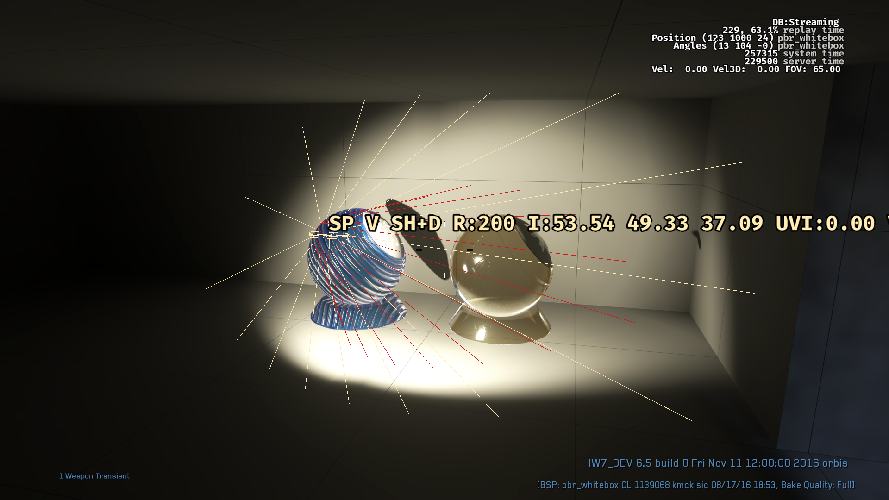
© 2017 Activision Publishing, Inc.
Analytic Light Shape
Notes:
Let’s take a look at typical analytical area light – bound inside of a frustum cone.

Slide 60
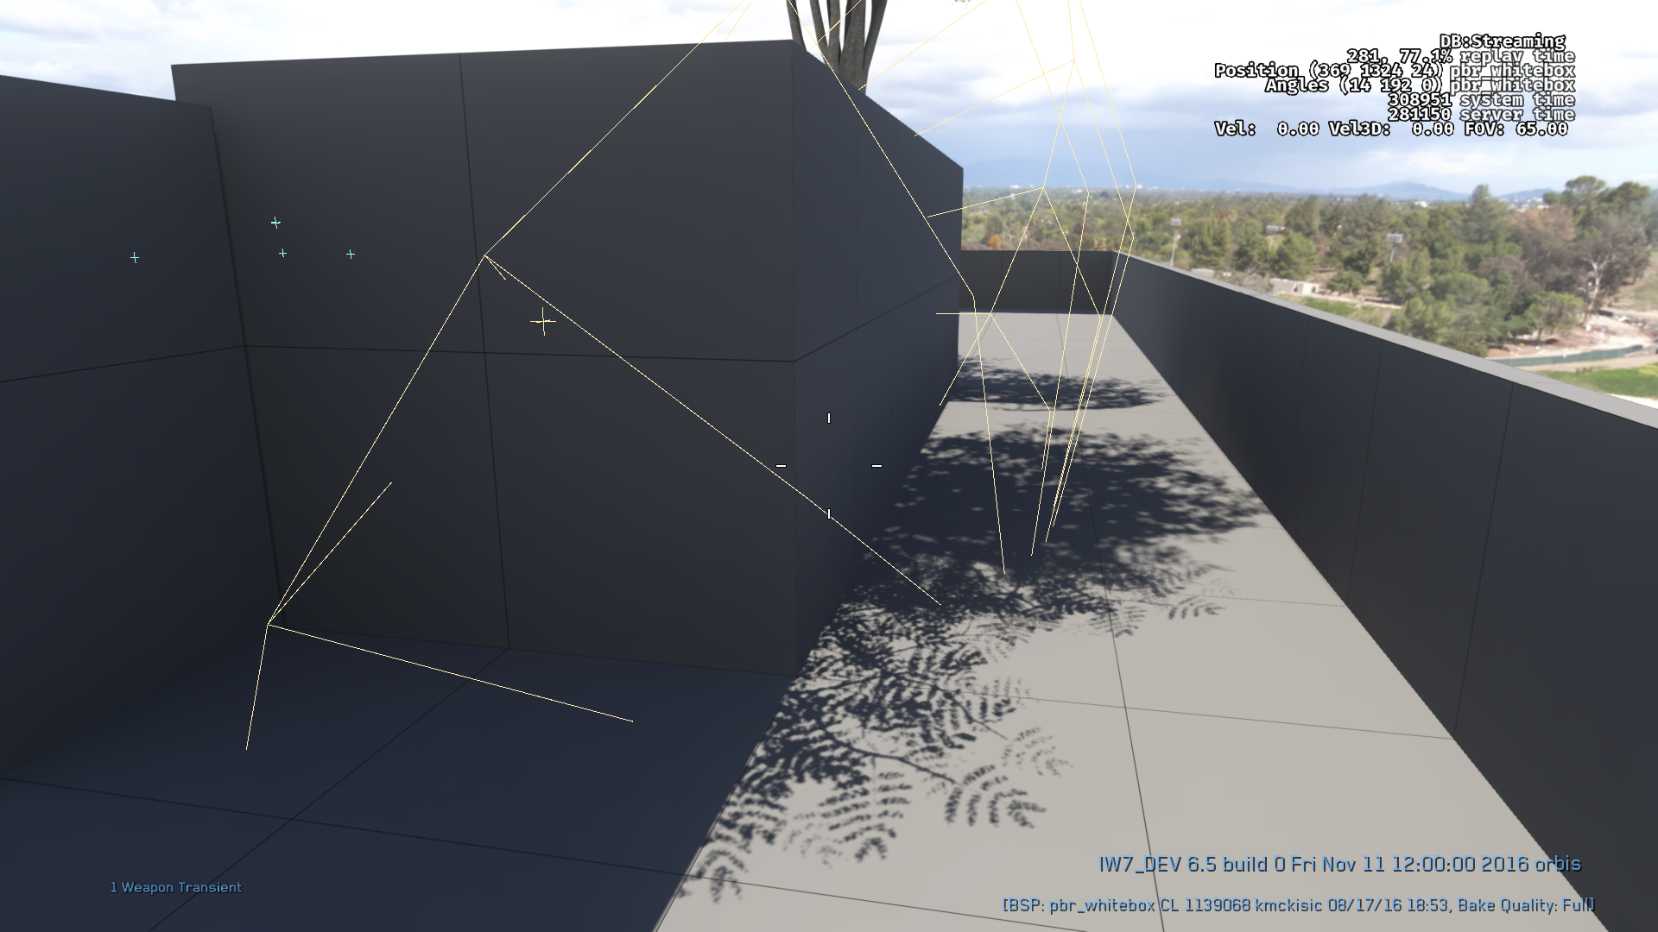
Analytic Light Shape
Analytic light shapes do not respect occlusion
Result in expensive over-shading
Visually corrected by shadow maps

Slide 61
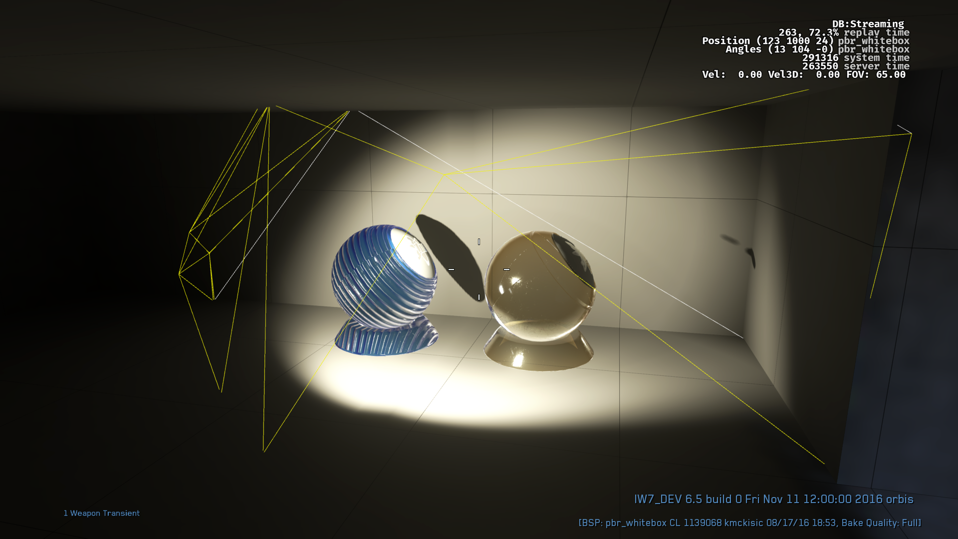
© 2017 Activision Publishing, Inc.
Light Proxy
Notes:
Light Proxy geometry is tightly cut to level geometry ( ~300 tris )

Slide 62
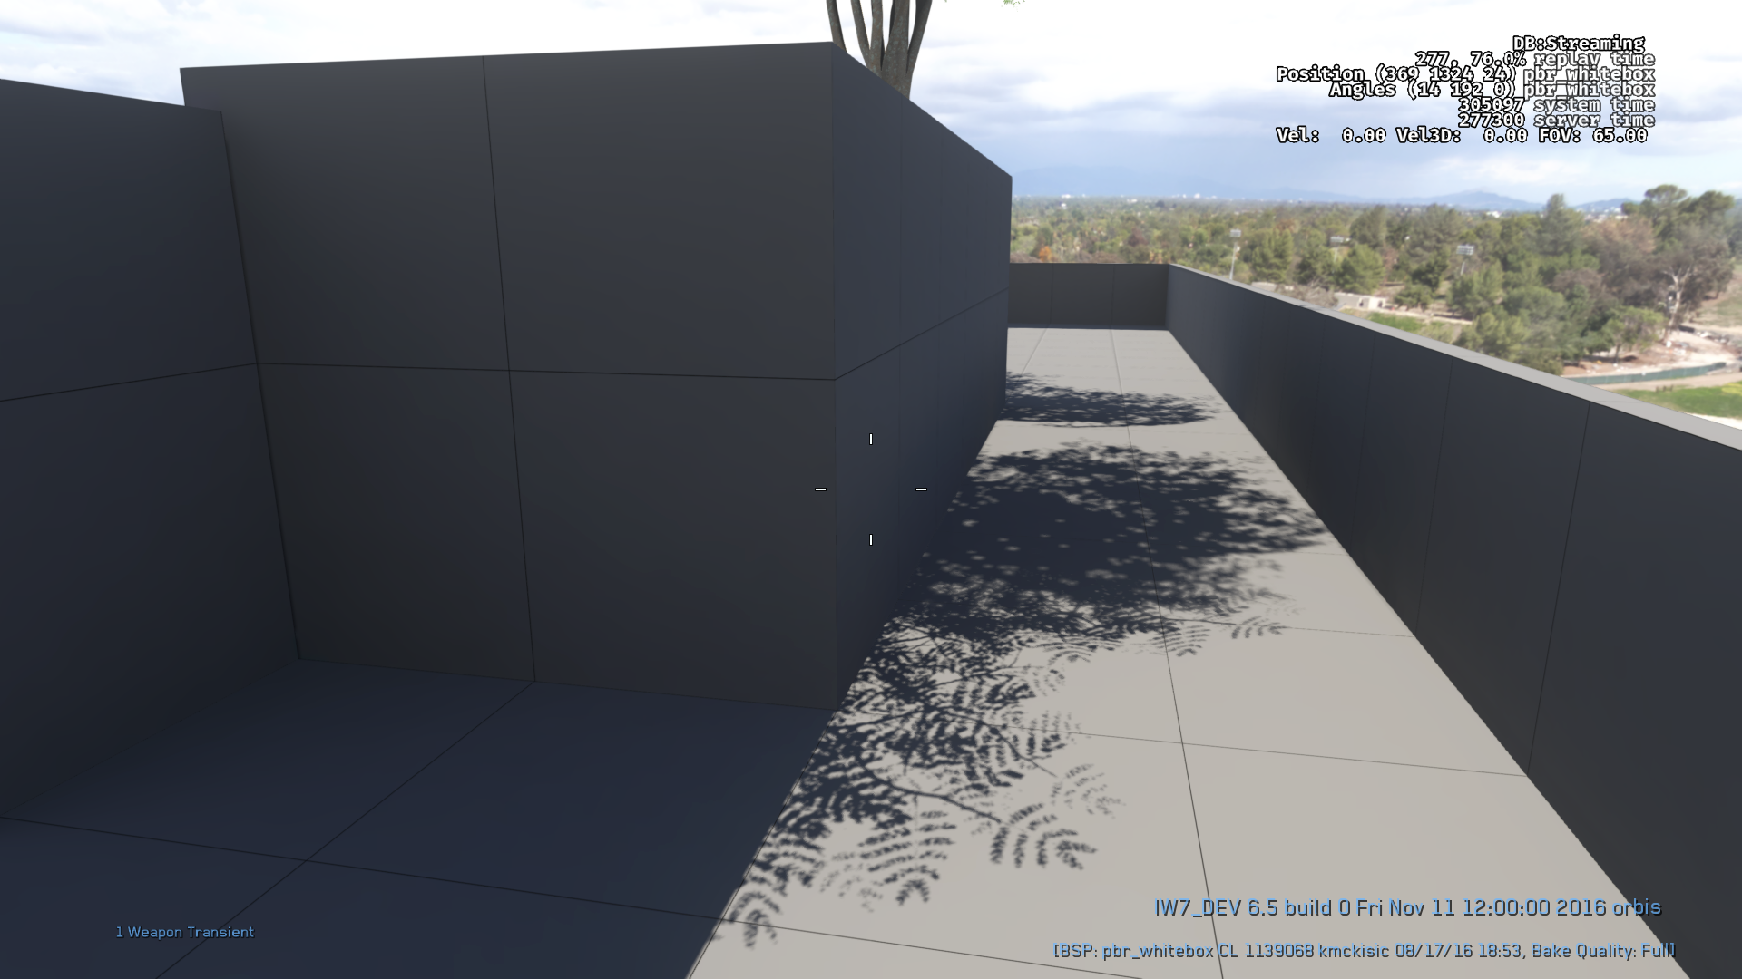
© 2017 Activision Publishing, Inc.
Light Proxy
Light Proxy geometry is tightly cut to level geometry ( ~300 tris )
Result in precise cull
Minimal over-shading

Slide 63
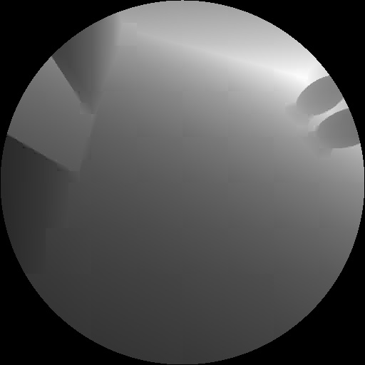
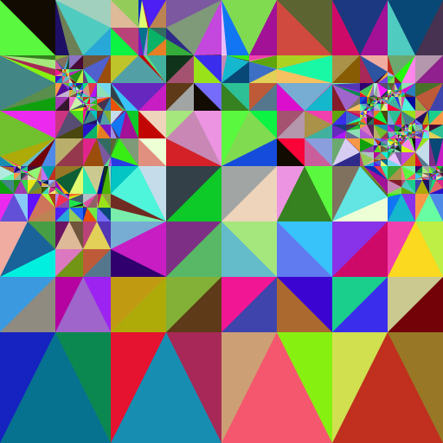
© 2017 Activision Publishing, Inc.
© 2017 Activision Publishing, Inc.
Proxies generated for all stationary lights
Conservative Shadow Map rendering
Triangulation of CSM
Triangulation optimization
Greedy plane fitting to CSM depth for Low Tri Proxies

Slide 64
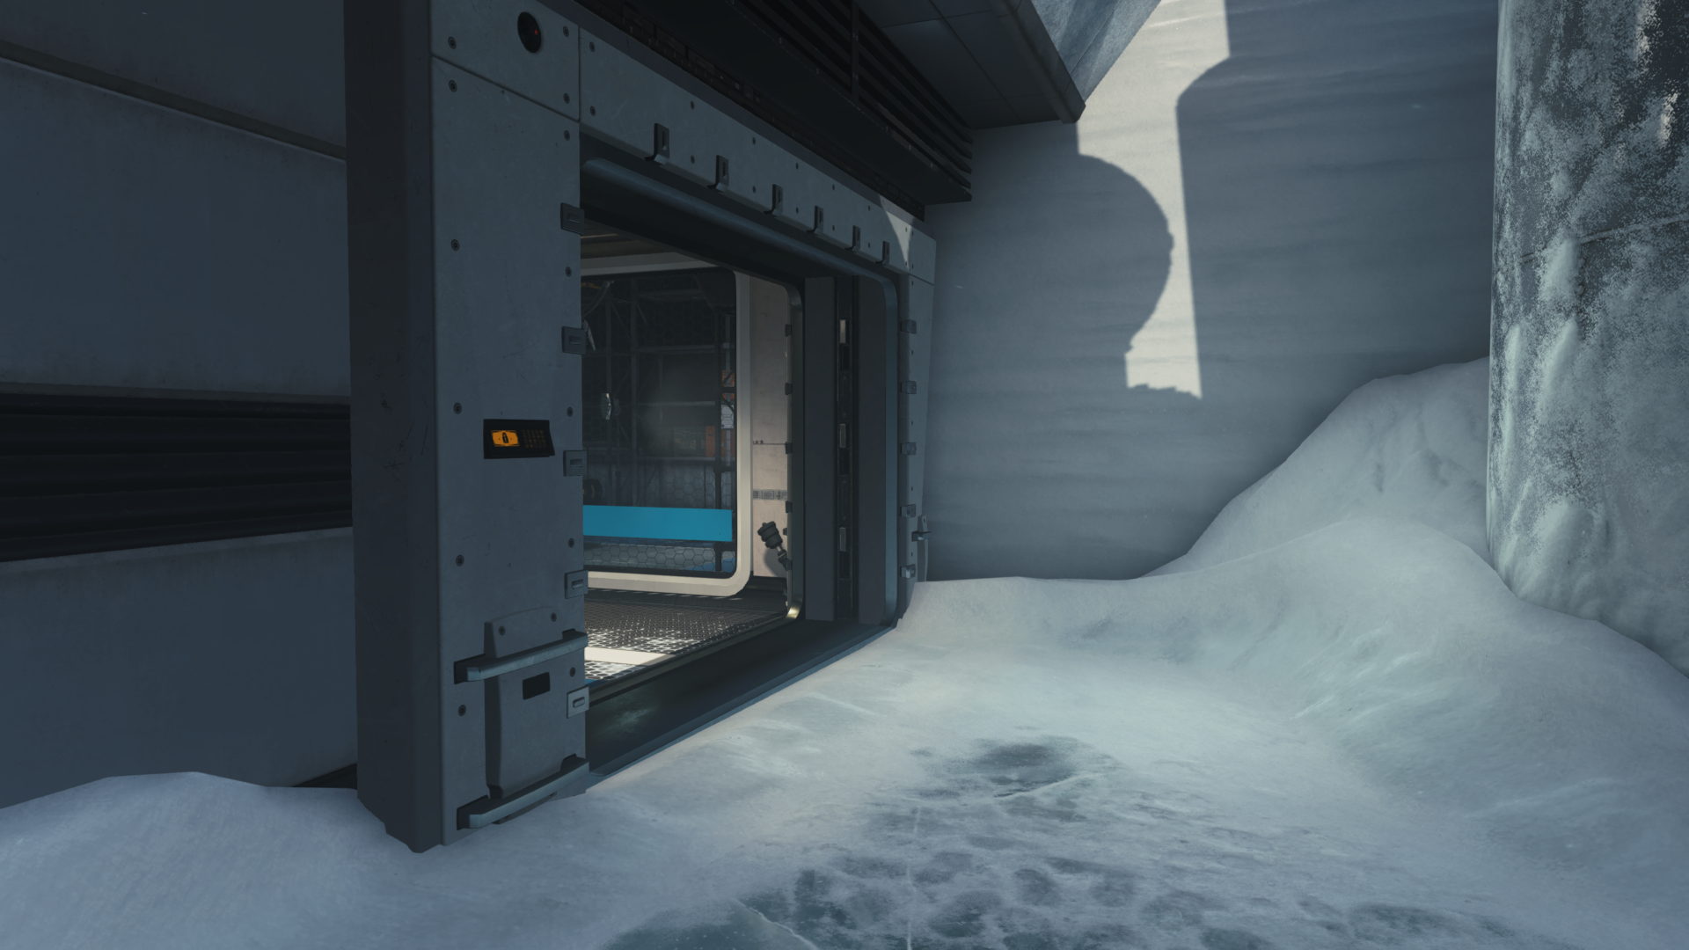
© 2017 Activision Publishing, Inc.
Proxy Light Shape
Notes:
Over-shading will still exist with light proxies.
Partially due to low triangle count, and partially to coarse shading method we are using.

Slide 65
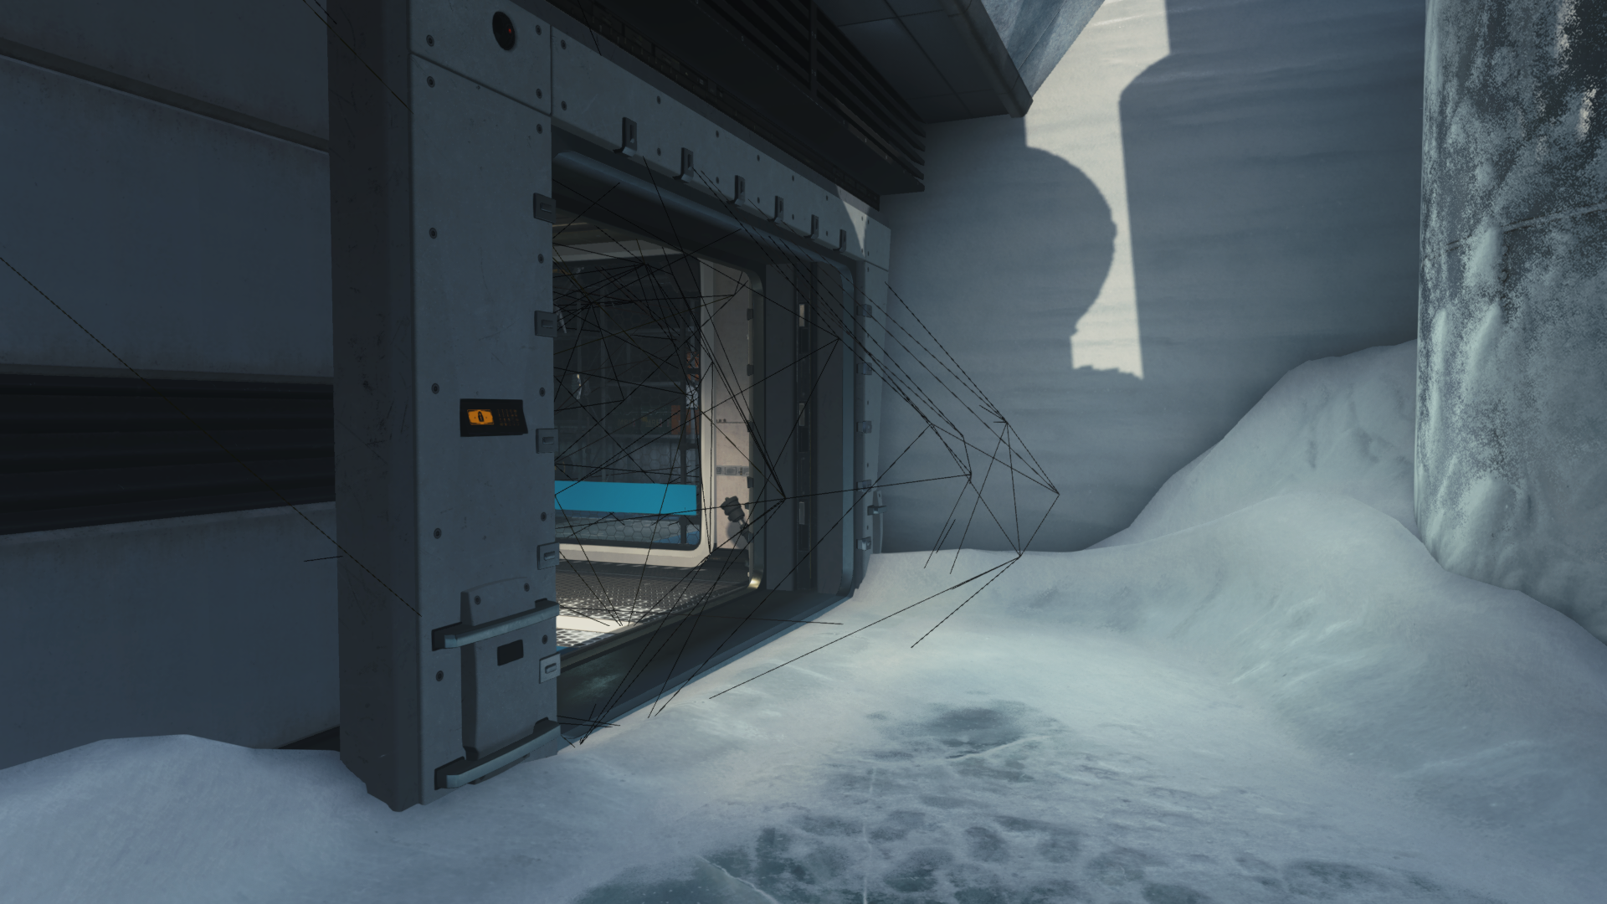
© 2017 Activision Publishing, Inc.
Proxy Light Shape
Shadowed Proxy
Notes:
As you can see the proxy mesh is slightly ‘poking’ through geo on the wall. Also it has partial overlap over ground triangles.

Slide 66
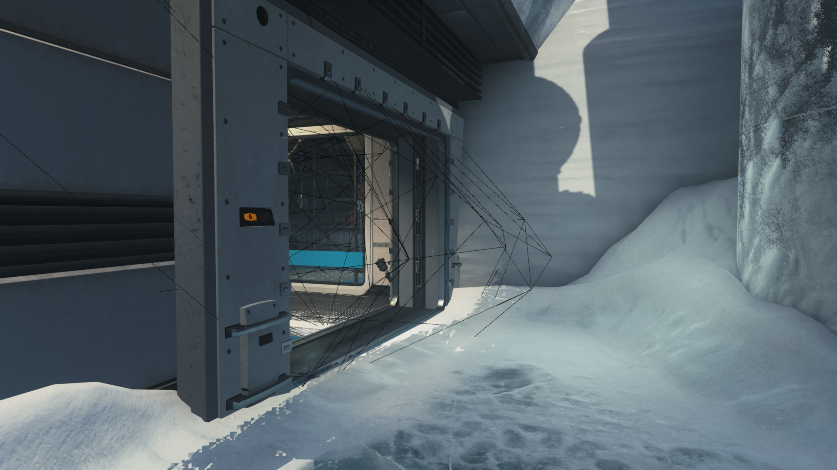
© 2017 Activision Publishing, Inc.
Proxy Light Shape
Un-Shadowed Proxy
Used to generate 8x8 tile buffer
Proxy intersection will be 8x8 tile ‘harsh’ visually if not masked
Static Shadow Map required for all lights
Use shadow map caching [DRO17]
Notes:
Because meshes are used to conservatively rasterize to 8x8 pixel tiles ( and furthermore we force them to work on wavefront boundaries ), edge between light and shadow, will be render at same granularity.
Therefore it is crucial to have shadow maps for all lights. This is covered by our static shadow map caching system.
Every light, at bare minimum, will have a shadow map of all static geometry – same as used for proxy generation.

Slide 67
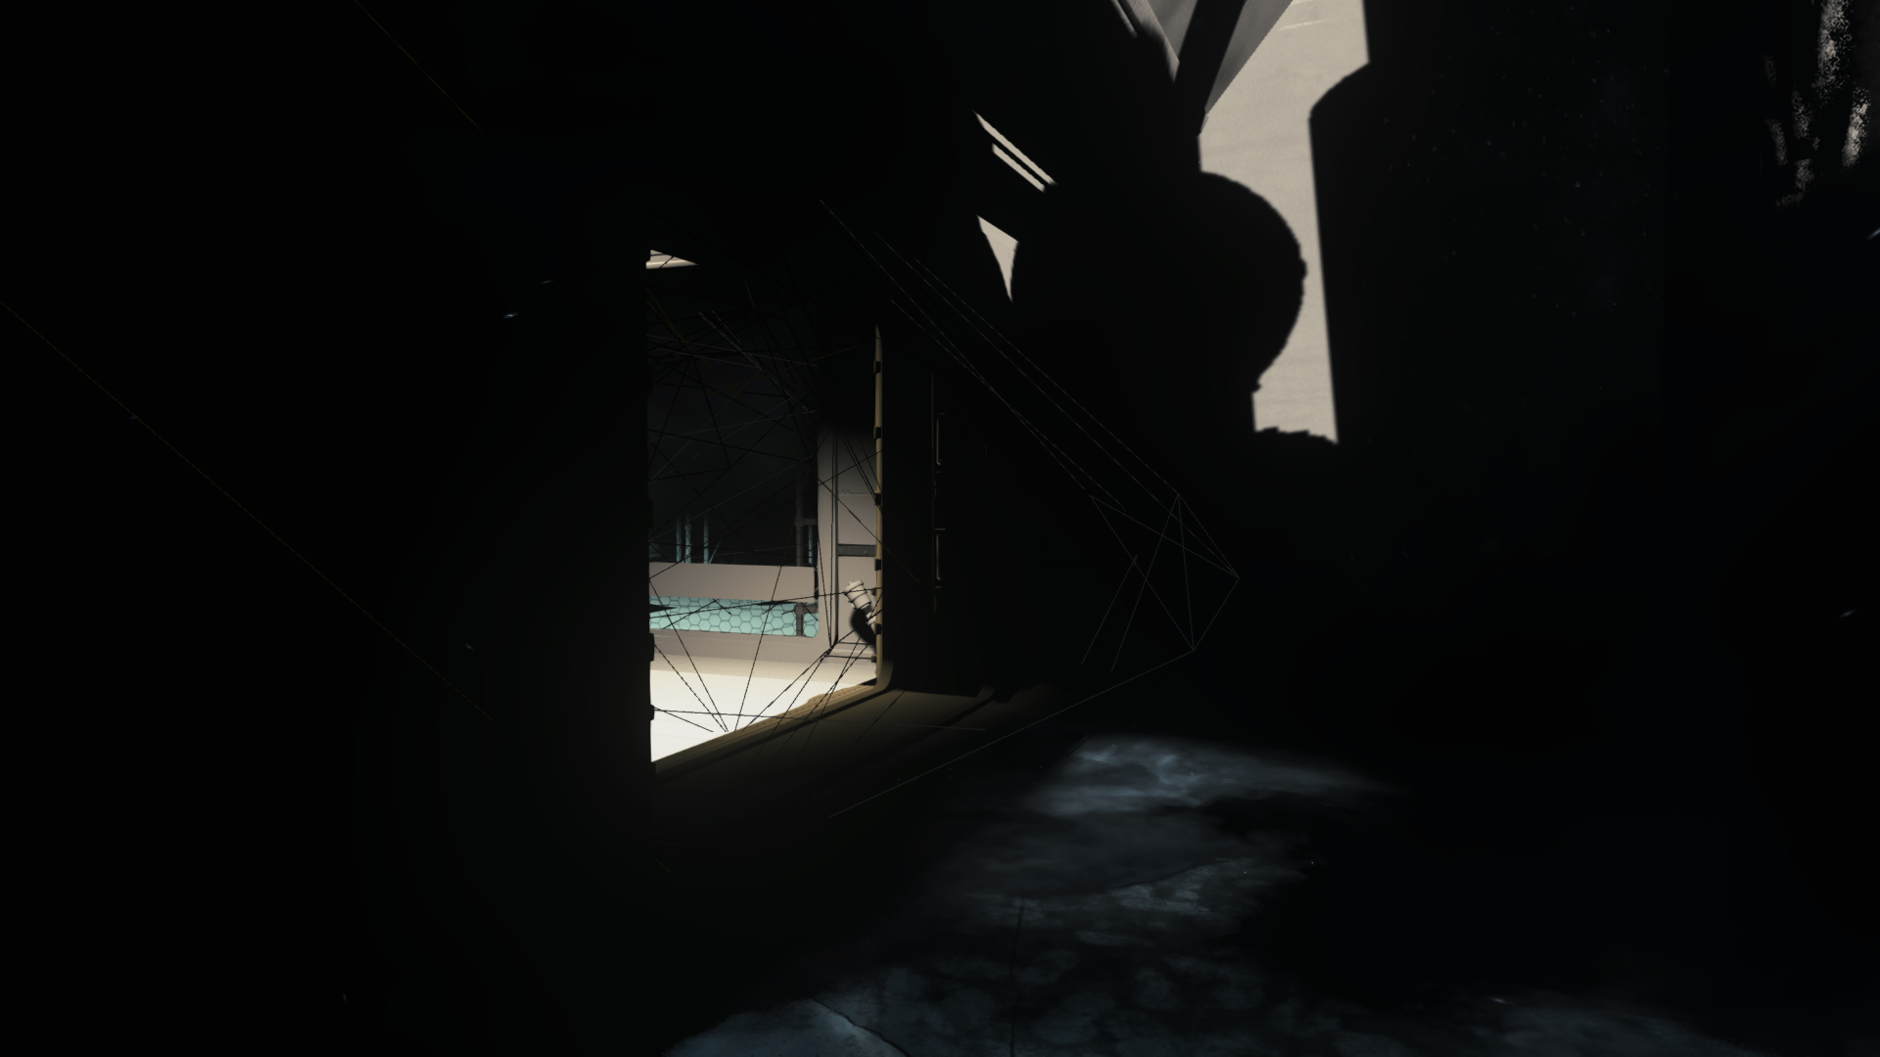
© 2017 Activision Publishing, Inc.
Proxy Light Shape
Shadowed Proxy
Notes:
Another view with direct light only.

Slide 68
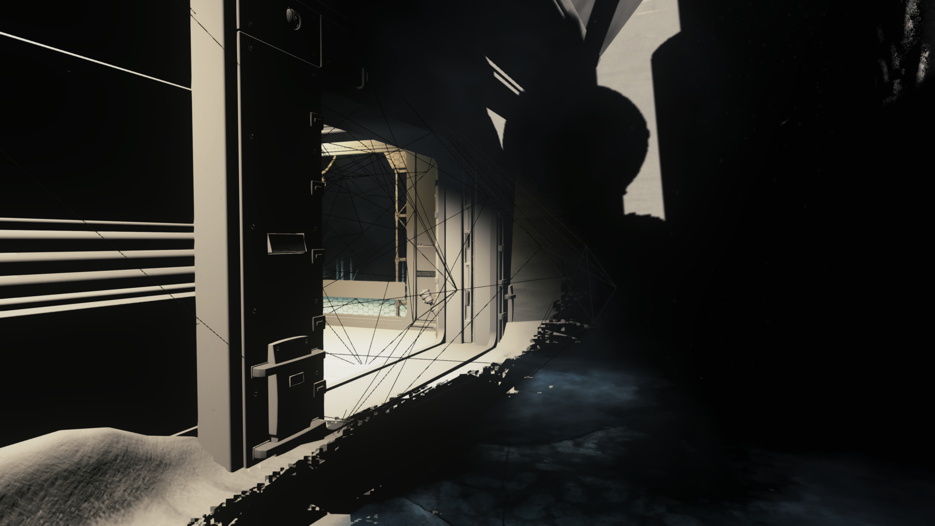
© 2017 Activision Publishing, Inc.
Proxy Light Shape
Un-Shadowed Proxy
Notes:
Another view with direct light only showing artifacts.

Slide 69
Light Proxy Performance
Open vista in Zombies ( minimal light occlusion ) - (PS4)
Light Shapes | Frame Time
Default | 16.5 ms
Light Proxies | 15.6 ms
0.9ms
Space ship corridor ( good light occlusion ) - (PS4)
Light Shapes | Frame Time
Default | 17.5 ms
Light Proxies | 14.4 ms
3.1ms
Good candidate for async overlap
Majority of work is utilizing GPU fixed pipeline
Long Atomic queues
Long WALK loops
Good balancing with CS based culling jobs for ‘simple’ cases
Notes:
Performance of light proxies will be highly content dependent.
Well authored lights, in cases with minimal occlusion will not benefit much.
Urban environments, corridors, man made structures will benefit most due to natural occlusion.

Slide 70
Improvements
Extend proxies to more rendering entities
Complex shape decals
Complex shape reflection probes
Improve rasterization batching
Sorting by Z allows efficient batching
Merge meshes in groups of lightBit % 32
WaveAllBitOr(lightBit) before InterlockedOR
Batch stencil passes in groups of lightBit % 32
Manual stencil write / read ( to R32_UINT texture ) <no HiS>
WaveAllBitOr(lightBit) before manualStencil.Store
Try only if base stencil optimization helps your content
8xMSAA

Slide 71
Rendering presentations 2017
EGSR
Ambient Dice Michal Iwanicki
Siggraph
Indirect Lighting in COD: Infinite Warfare Michal Iwanicki
Dynamic Temporal Supersampling and Anti-Aliasing Jorge Jimenez
Improved Culling for Tiled and Clustered Rendering Michal Drobot
Practical Multilayered Materials in COD: Infinite Warfare Michal Drobot
Microsoft XFest 2017
Optimizing the Renderer of Call of Duty: Infinite Warfare Michal Drobot
research.activision.com

Slide 72

JOIN US
www.activisionblizzard.com/careers

Slide 73
Special Thanks
Rasterized Culling
Paul Edelstein
Johan Kohler
Michael Vance
Proxy Generation
Peter-Pike Sloan
Peter Pon

Slide 74
Additional Thanks
IW Rendering Team
Anthony Carotenuto, Rulon Raymond, Peter Pon, Mike Esposito, Vishal Kashyap, Felipe Gomez
Activision Central Tech
Infinity Ward
Sledgehammer Games
Treyarch
Raven

Slide 75


Q&A
research.activision.com
michal@infinityward.com
@MichalDrobot

Slide 76
References
[DRO14] “Low Level Optimizations for GCN”, Michal Drobot, Digital Dragons 2014
[DRO17] “Rendering of Call of Duty: Infinite Warfare”, Michal Drobot, Digital Dragons 2017
[HAR04] “Deferred Shading”, Shawn Hargreaves, Mark Harris, 2014
[HEI16] “Real-Time Polygonal-Light Shading with Linearly Transformed Cosines”, Eric Heitz, Jonathan Dupuy, Stephen Hill and David Neubelt, Siggraph 2016
[JOH09] “Parallel Graphics in Frostbite – Current & Future”m Johan Andersson, Siggraph 2009
[KAS11] “Secrets of CryENGINE 3 Graphics Technology”, Nickolay Kasyan, Nicolas Schulz and Tiago Sousa, Siggraph 2011
[SOU16] “The Devil is in the details : idTech 666”, Tiago Sousa, Siggraph 2016
[THI11] “Deferred Shading Optimizations”, Nicolas Thibieroz, GDC 2011
[WRO17] “Cull That Cone”, Bart Wronski, https://bartwronski.com/2017/04/13/cull-that-cone/

Slide 77
Bonus Slides

Slide 78
Spatial acceleration structure : World
Voxel Tree
World space Oct-tree
Each leaf is a ‘cube’ / voxel
Precomputed with occlusion
i.e. lights would be shadowed and contained to their volume of influence only
Allows easy precomputed / cached out-of-frustum 3D lookups
Expensive traversal
Need to traverse hierarchy, multiple $ misses, indirect reads
High memory consumption ( resolution dependent )
Significant pre-computation time
Notes:
Used in IW7 for out of frustum 3D lookups for : lights in dynamic reflection probes, lights for dynamic lightmapped particles, tetrahedron Global Illumination lightgrid

Slide 79
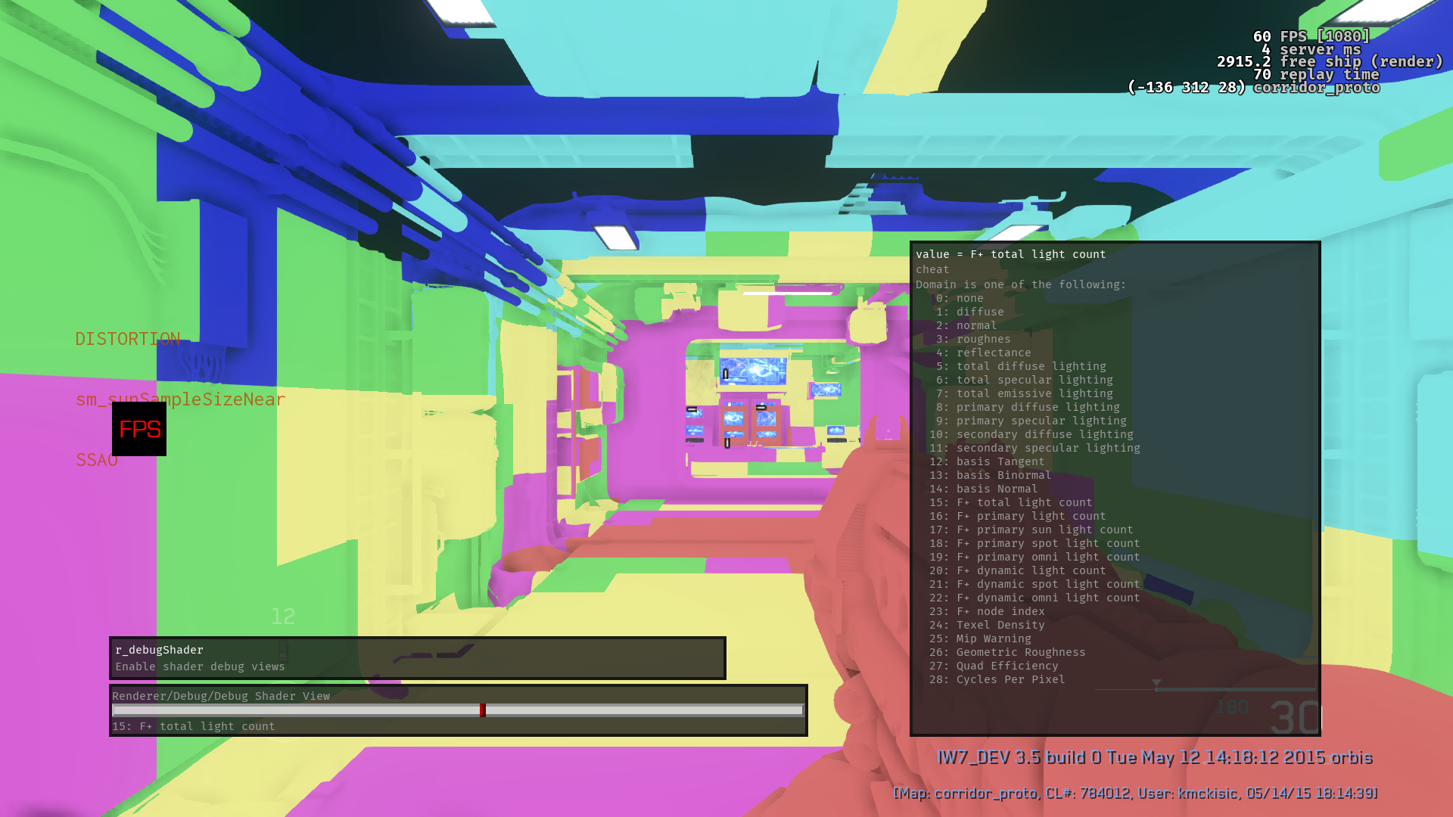
Voxel Tree F+
© 2017 Activision Publishing, Inc.
Notes:
Colors represent amount of lights hitting each pixel. Each voxel stores preculled lights.
It is shown here to demonstrate how world space voxels are visualized on surfaces ( not used for actual scene lighting ).

Slide 80
Spatial acceleration structure : World
Per-mesh Triangle / Texel
Precomputed with occlusion
Allows per-mesh lookup
Stored per-triangle ( triID ) or per-texel ( like a lightmap )
Medium memory consumption ( resolution dependent )
Arguably most efficient in Forward once cached
Complex pipeline – high caching time
An interesting experiment that did not ship
Looking forward to revisit in next projects

Slide 81
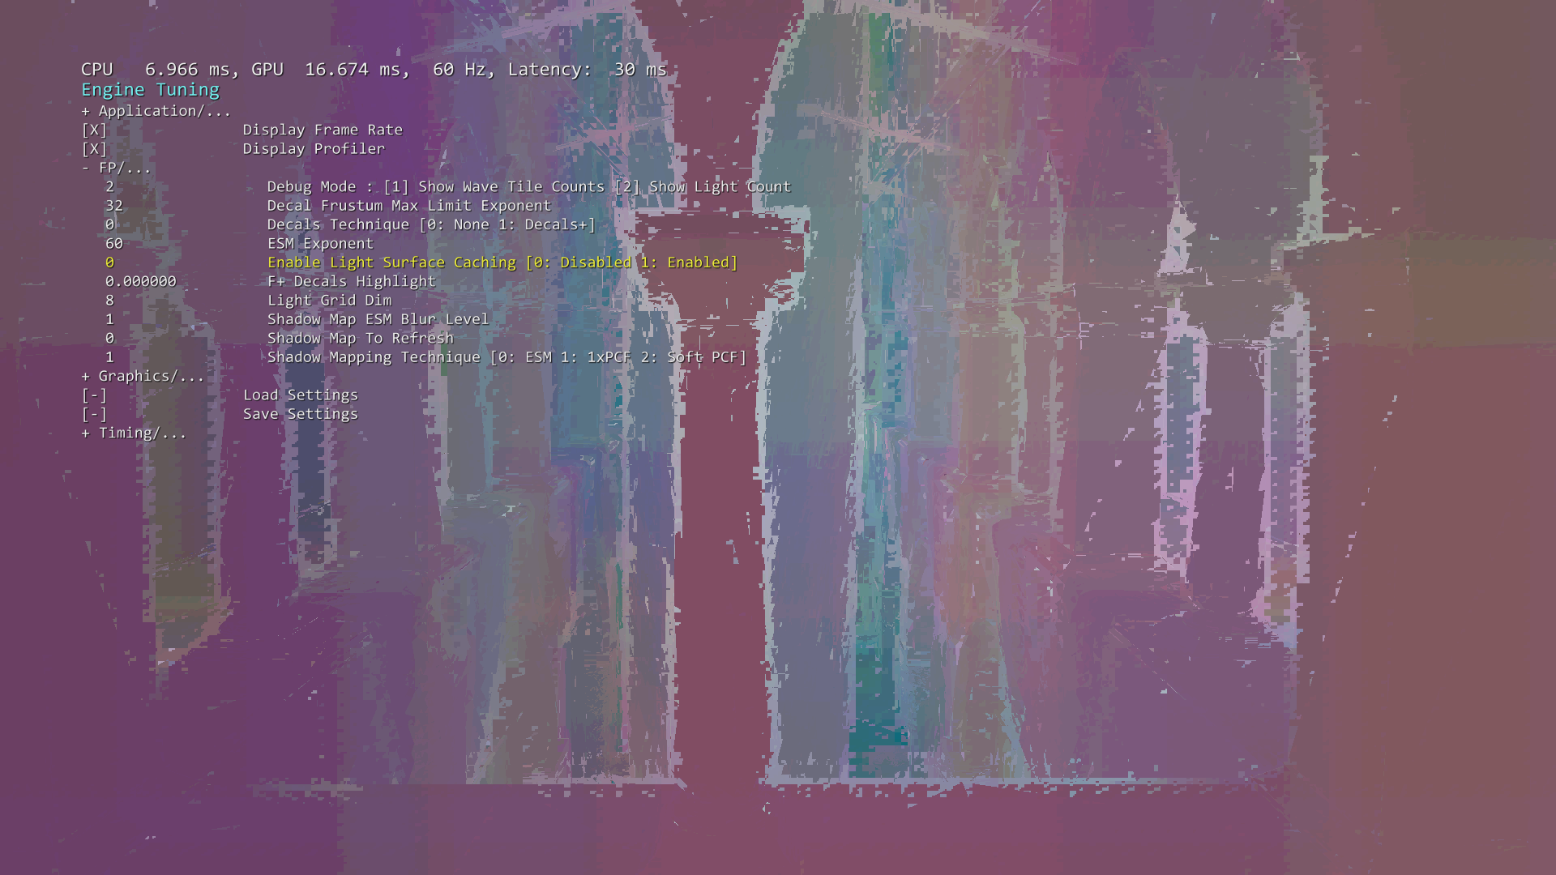
Spatial acceleration structure : World Based
© 2017 Activision Publishing, Inc.
128 shadowed lights
Clustered F+ : 13ms
Notes:
Results of standard Clustered F+ lighting. 16 Z slices ( more would help with depth discontinuities on edges ).
Colors represent amount of lights processed per pixel. [blue through red to white] -> [0…128]
The brighter the color – the more lights are processed

Slide 82
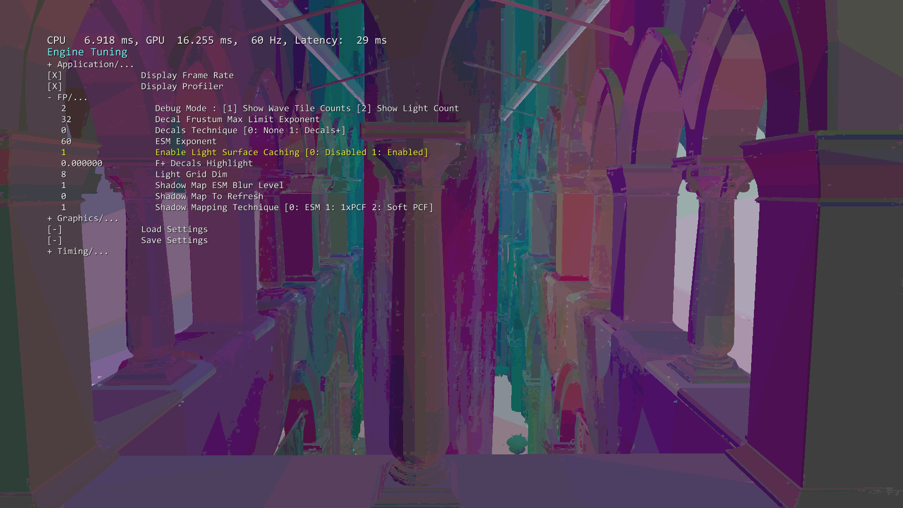
Spatial acceleration structure : World Based
© 2017 Activision Publishing, Inc.
128 Shadowed lights
Surface Cached F+ : 7ms
Shadow / back-face culling
Notes:
Surface caching enabled.
Each Triangle is shadow and back-face culled against lights. Depth discontinuities are naturally non-existent due to per-triangle nature of the algorithm.
Majority of performance improvement comes from backface culling which can not be done in non-surface based methods.
Shadow culling can be implemented in other methods, albeit at different performance / quality.
Great performance win of over 6ms - even though some large triangles tend to process too many lights. Better tessellation or switching to per-texel based approach would help.
Colors represent amount of lights processed per pixel. [blue through red to white] -> [0…128]
The brighter the color – the more lights are processed

